Slide 1


Energy-Economy-Environment (E3) Systems Analysis
Building decision-support tools to reduce the environmental impacts of technology systems and to understand the structural transformation necessary to navigate a peaceful transition to a prosperous and sustainable future.

Slide 2


About me
Mik Carbajales-Dale heads the E3 Systems Analysis group.
Associate Professor in Environmental Engineering at Clemson University
Energy Systems Analyst at Stanford University with the Global Climate & Energy Project (GCEP)
Ph.D. in Mechanical Engineering with the Advanced Energy and Material Systems (AEMS) Laboratory at the University of Canterbury, New Zealand
PI/Co-PI on over $30M of funding from Dept. of Energy, National Science Foundation, NASA, US Dept. of Agriculture
Over fifty peer-reviewed publications which have received over 2800 citations, h-index of 28
Chief Editor of Frontiers in Energy Research, Sustainable Energy Systems section
Co-chair of SETAC/ACLCA Working Group on LCA for Emerging Technologies

Slide 3








The team
Jacob Arnold
PhD Candidate
Resilient infrastructure
Elif Can
Research Associate
Critical minerals
Hao Chen
PhD Candidate
Advanced manufacturing
Muzan Ijeoma
PhD candidate
Net-negative buildings
Shohreh Kamyab
PhD Candidate
Sustainable agriculture
Garrett Lewis
BS Candidate
Solar PV in Nigeria
Harish Srinivasan
MS Candidate
Wastewater treatment
Cole Van Emburg
BS Candidate
Light duty vehicles

Slide 4









What we do
Macro:
National/global scale: we use geographic information systems (GIS) to assess the availability and suitability of resources and infrastructure and environmentally-extended input-output (EEIO) to represent the structure of economies and understand necessary changes for transition
GIS
EEIO
Meso:
Industry scale: techniques include material flow analysis (MFA), network analysis (NA), agent-based modeling (ABM), and systems dynamics (SD) to explore issues related to technology development and investment management strategies in the face of resource constraints
MFA
NA
ABM
SD
SD
ABM
Micro:
Device/facility scale: building engineering-based bottom-up life cycle assessment (LCA) models to generate rigorous estimates of environmental impacts as well as techno-economic analysis (TEA) models to evaluate financial costs
LCA
TEA

Slide 5

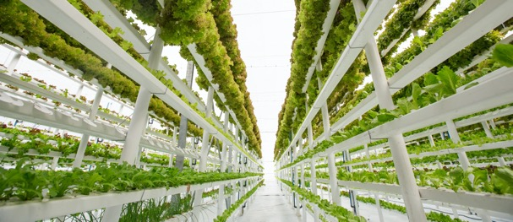

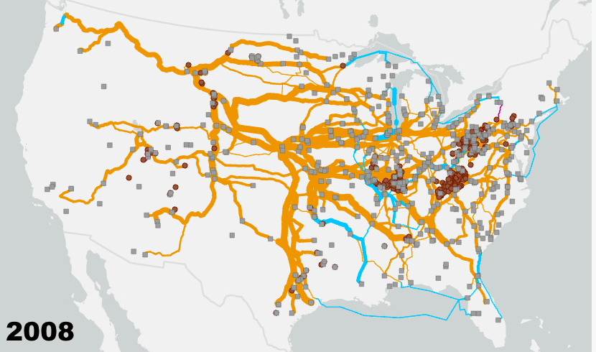
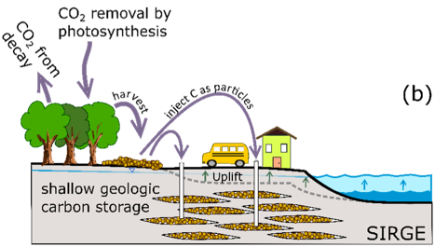
Sample projects
Net negative carbon buildings
Development of an entirely wood floor system designed for biogenic carbon storage, adaptability, and end-of-life (de/re)construction
LCA of Light Duty Vehicles
From blue-gray to blue-green: facilitating the transition to non-plastic natural material use within the coastal zone economy
Climate resilient agriculture
Climate resilient, sustainable food production: controlled environment hydroponic agriculture
AIM for composites
Energy Frontiers Research Center (EFRC): Artificially Intelligent Manufacturing Paradigm for Composites
Rolling coal
Multi-modal network analysis of environmental impacts of moving coal for electricity generation
Carbon SIRGE
Injecting solid, carbon-bearing particles into geologic formations will remove atmospheric carbon and simultaneously reduce flood risk

Slide 6

Net negative carbon buildings

Slide 7
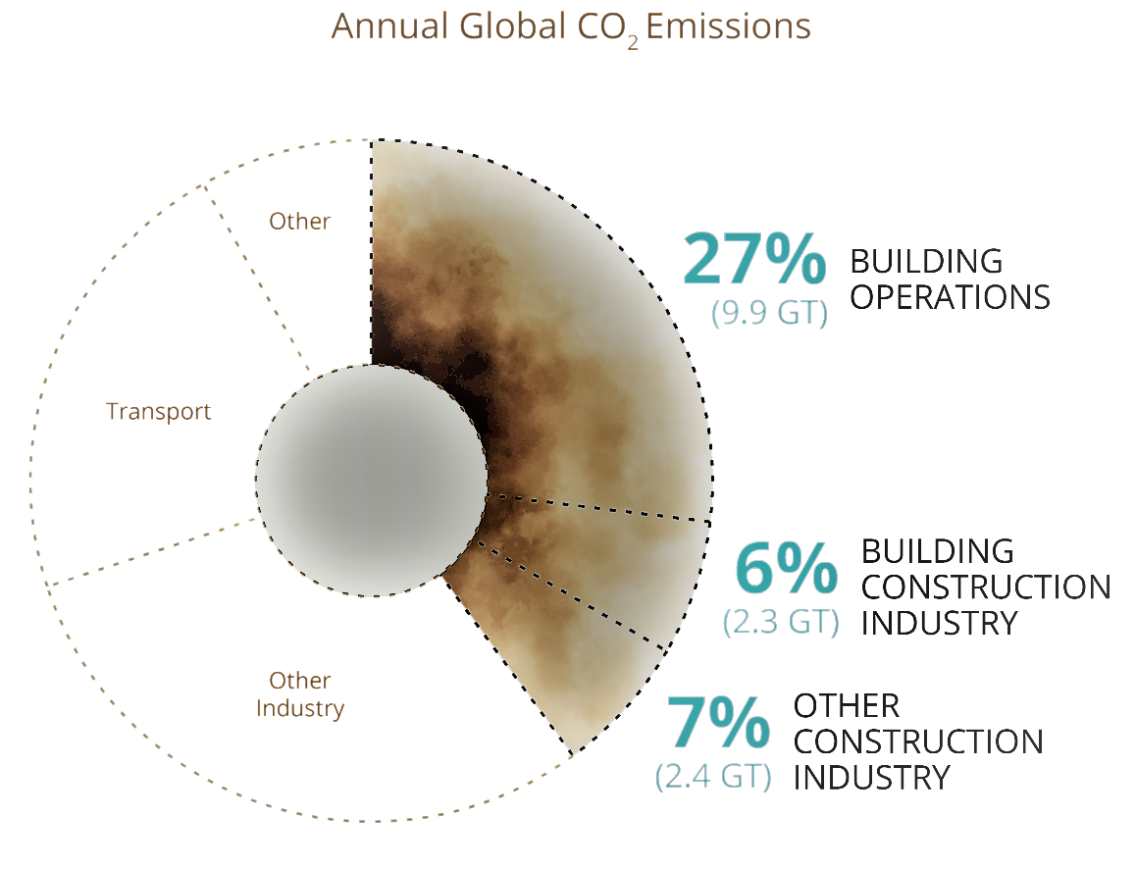
Net negative carbon buildings
23% of global emissions are due to production of concrete (11%), steel (10%), and aluminum (2%), much of which is used within the construction industry
As grids decarbonize, embodied carbon is expected to become a larger piece of the pie
As such, methods to reduce embodied carbon in construction will become increasingly important
IEA (2022), Buildings, IEA, Paris

Slide 8
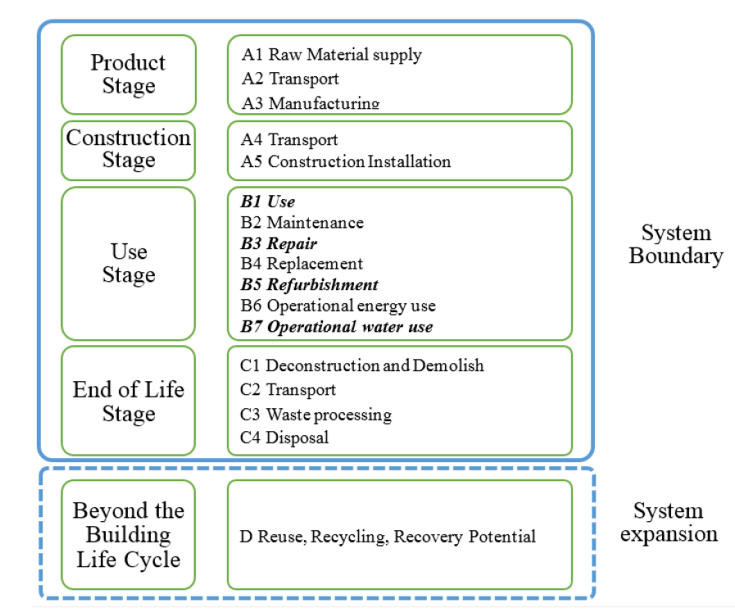
Net negative carbon buildings
Method includes all stages within the EPD framework
Chen Z. et al., 2020

Slide 9
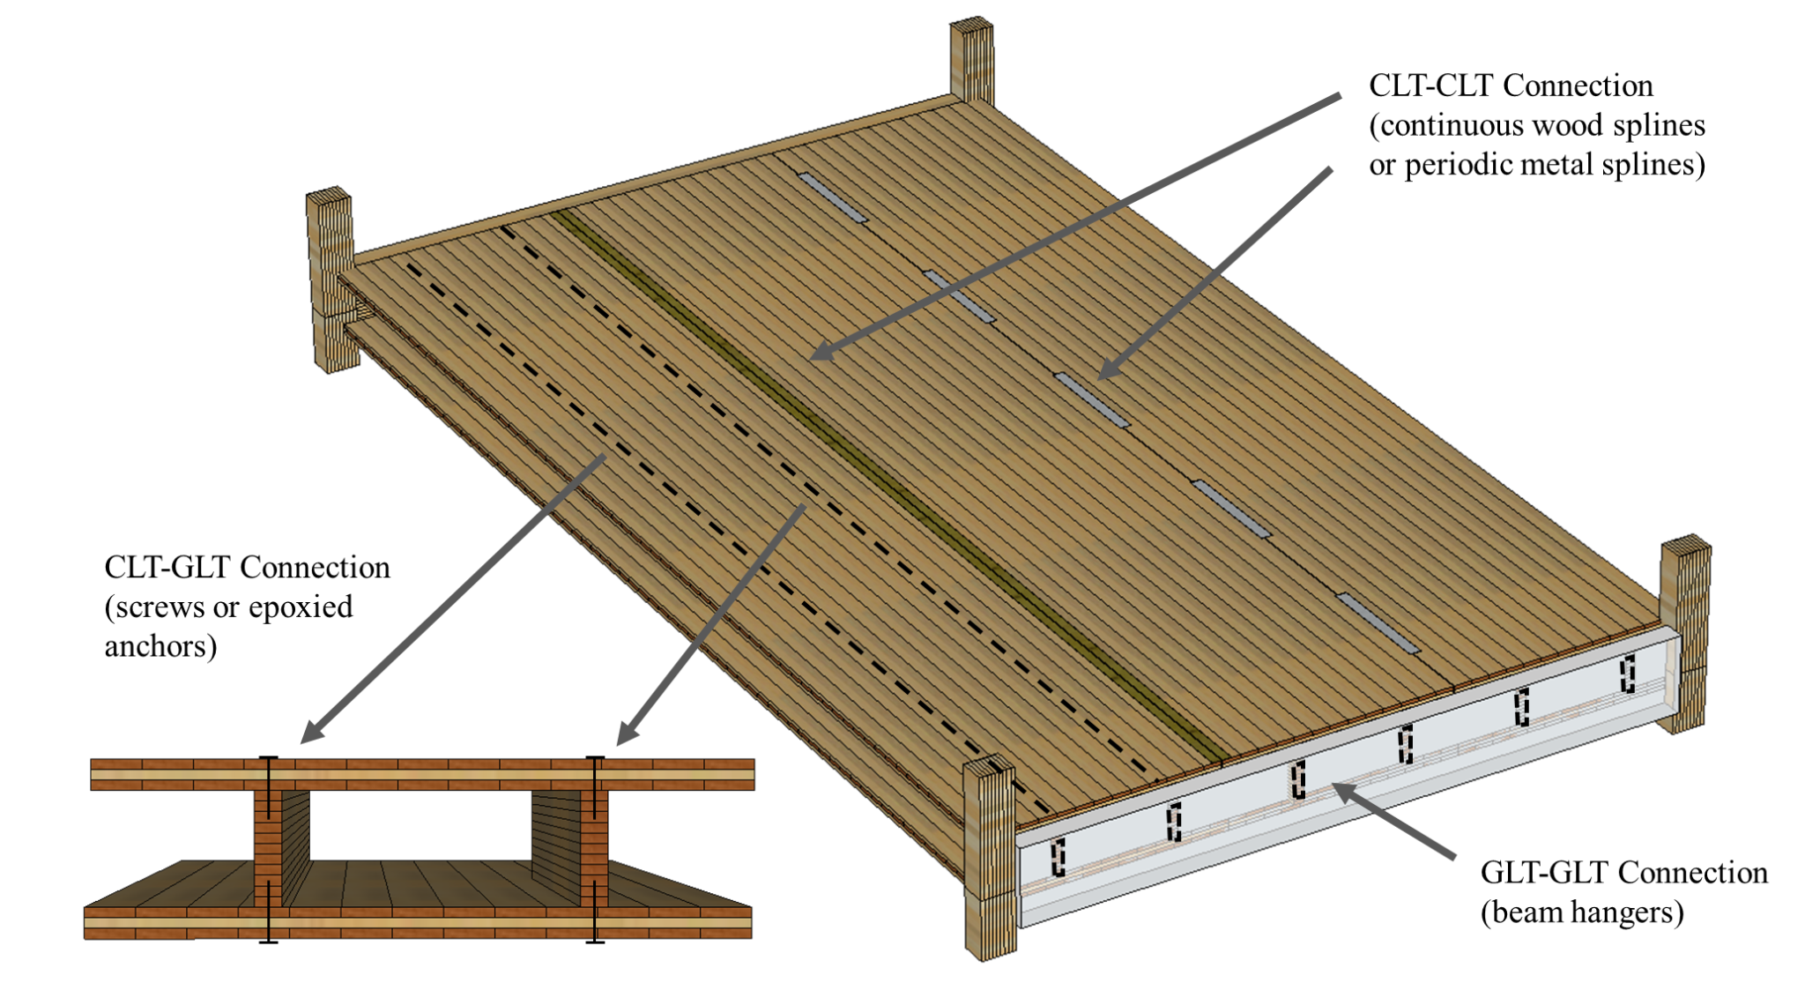
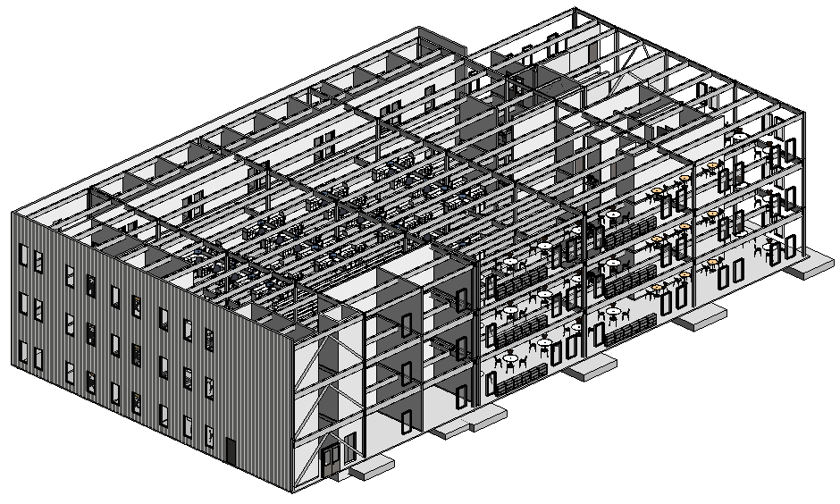
Net negative carbon buildings
Design steel-concrete reference building in Revit
Redesign building using mass-timber system

Slide 10
Net negative carbon buildings
Potential benefits of eliminating concrete from buildings
No concrete flooring
Lower dead load
No concrete foundation
Lower construction time
Lower construction cost
Lower embodied carbon
SNOWBALLING BENEFITS

Slide 11

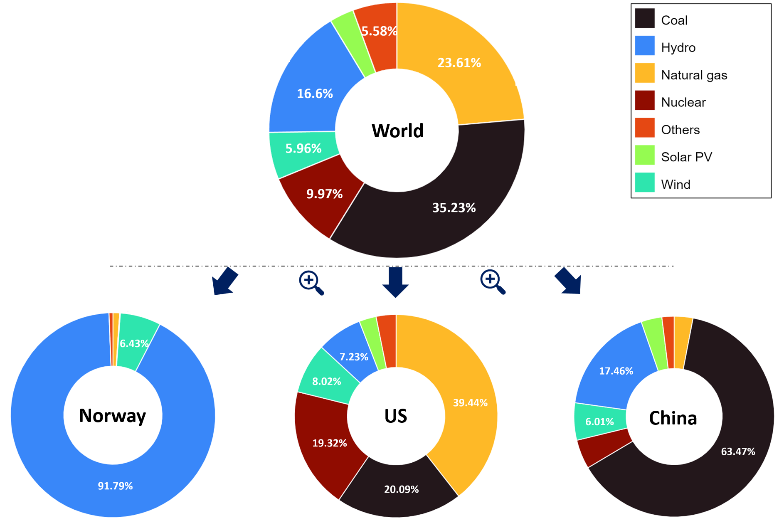
Light-duty vehicles
Electric transportation has been promoted in recent years due to its potential for zero tailpipe emissions and reduced reliance on fossil resources.
Electric vehicle sales are growing exponentially: 10 million cars were sold in 2022, accounting for 14% of total vehicles, and this share is expected to reach 35% by 2030 (IEA, 2023)
Four main types:
  internal combustion engine vehicles (ICEVs)
  hybrid electric vehicles (HEVs),
  plug-in hybrid electric vehicles (PHEVs), and
  battery electric vehicles (BEVs)
A big push for BEVs has been extending vehicle range
Few studies expand beyond GHGs to draw comprehensive conclusions based on multiple environmental indicators
Rapid e-mobility transformation in Euro.
2nd global EV inventory and 55% increase sale in 2022.
1st global EV inventory and explosive market growth in recent years

Slide 12
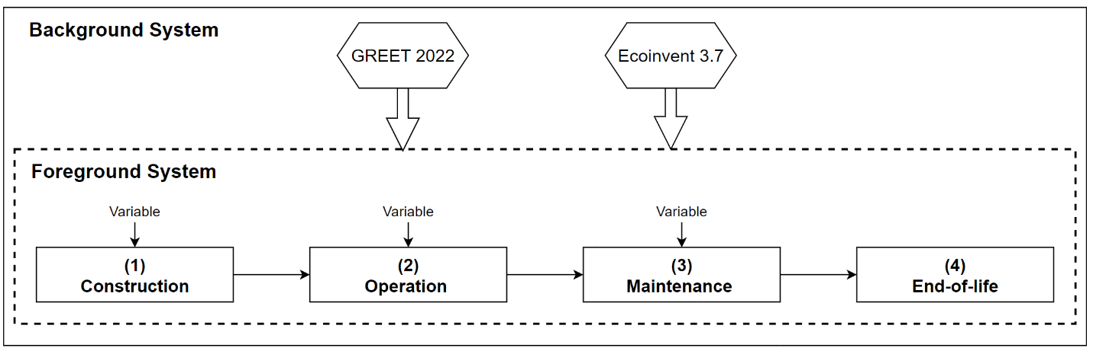
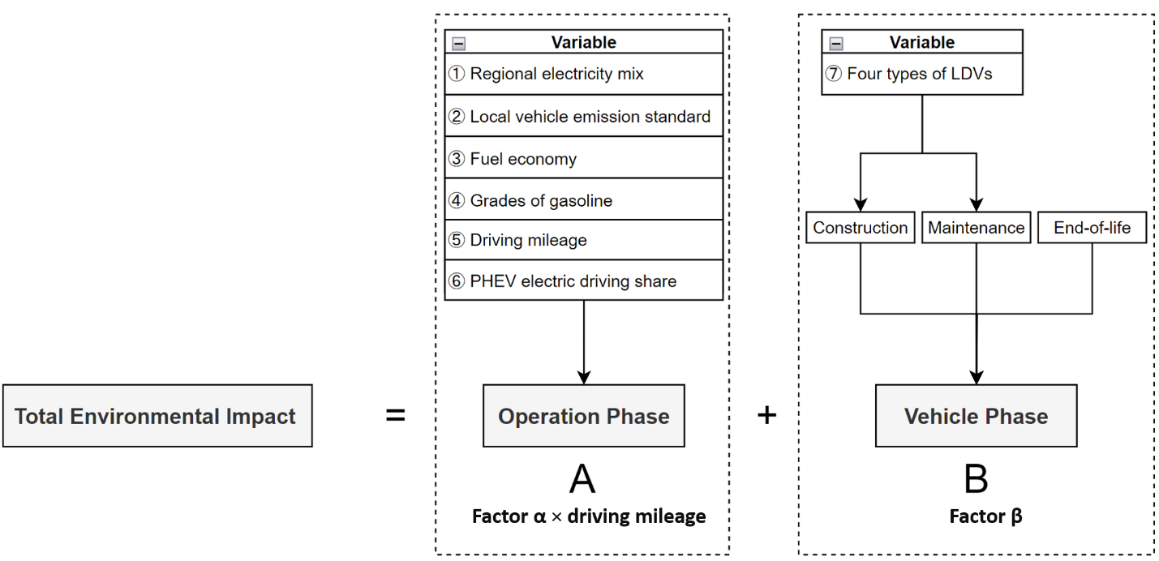
LCA of light-duty vehicles

Slide 13
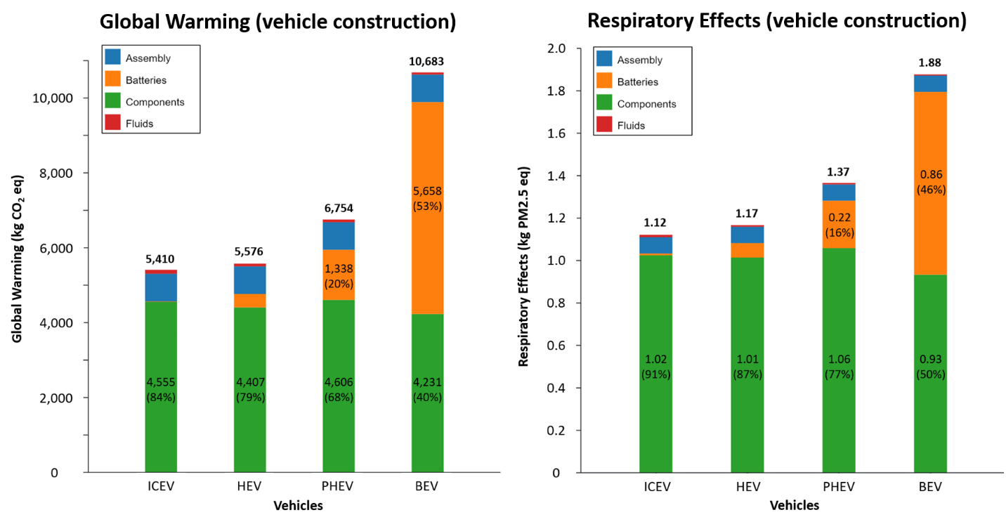
LCA of light-duty vehicles
BEVs have larger up-front impacts
Whether BEVs can offset this additional impact depends on operational location and usage

Slide 14
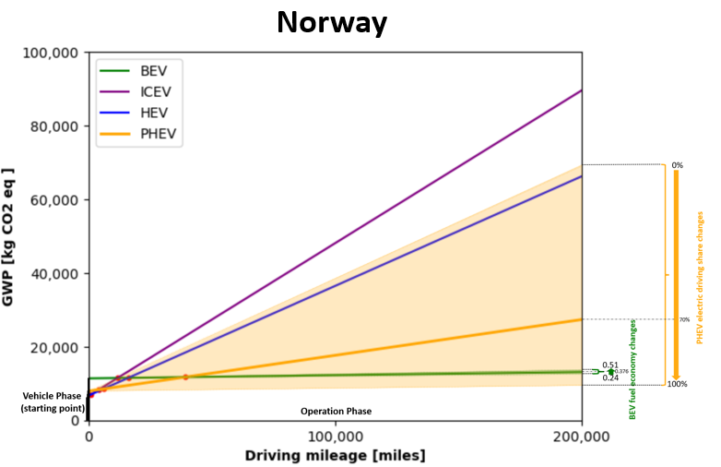
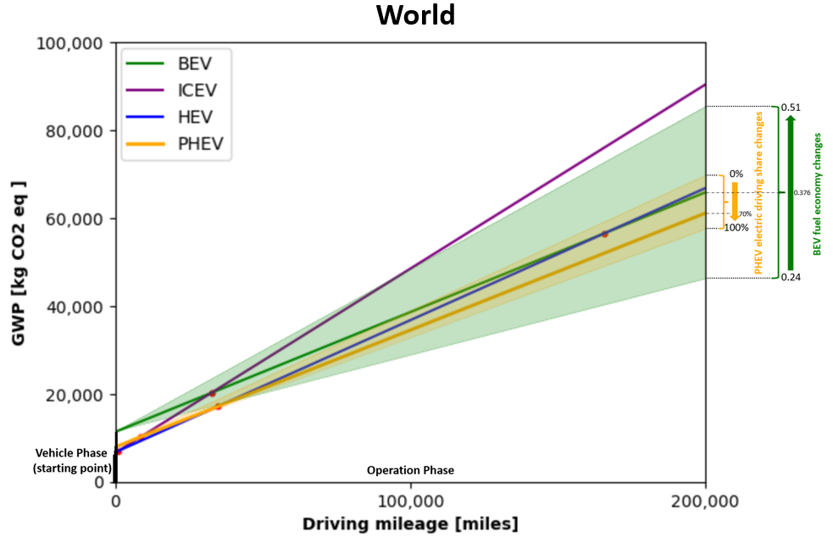
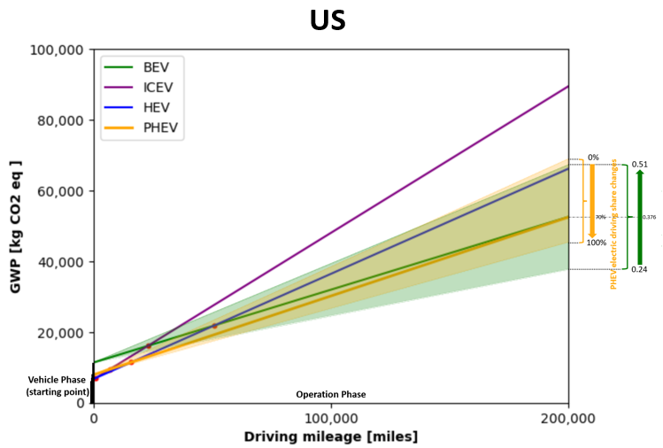
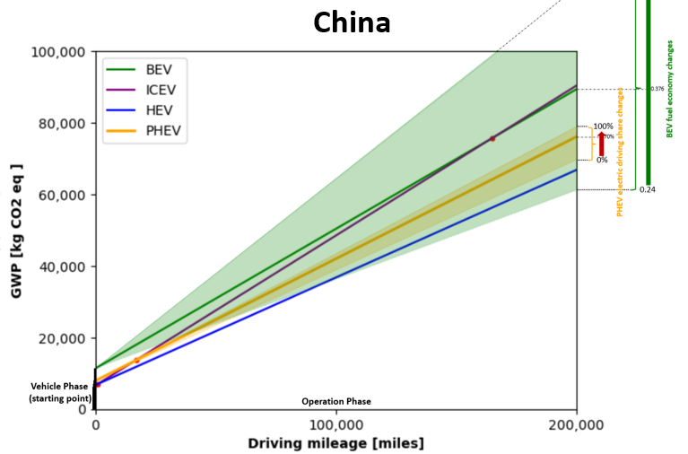
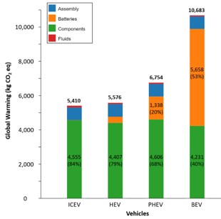
LCA of light-duty vehicles
BEVs impacts (green) vary due to uncertainty in fuel economy [kWh/mile]
PHEV impacts (yellow) vary due to uncertainty in share of driving on electric vs. gasoline
HEV (blue) and ICEV (purple) impacts vary only by total mileage

Slide 15
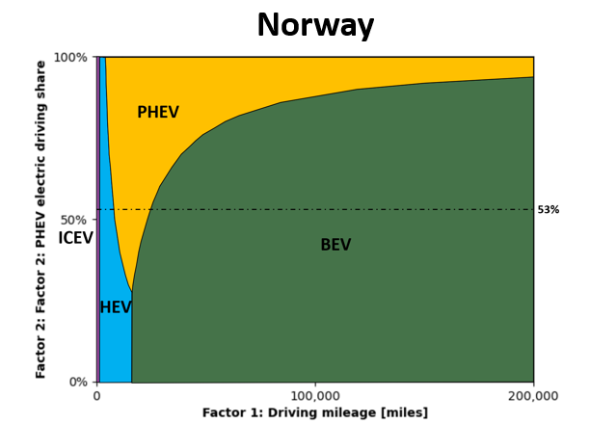
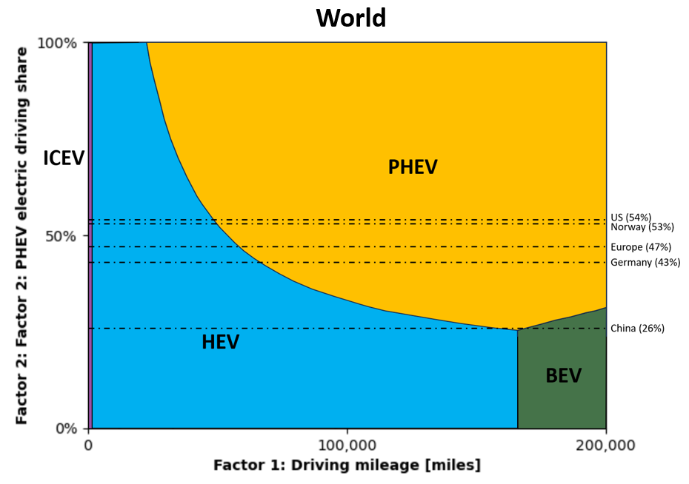
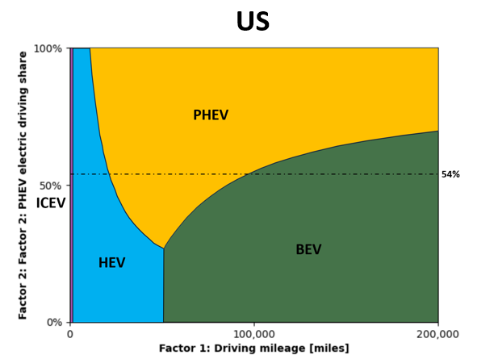
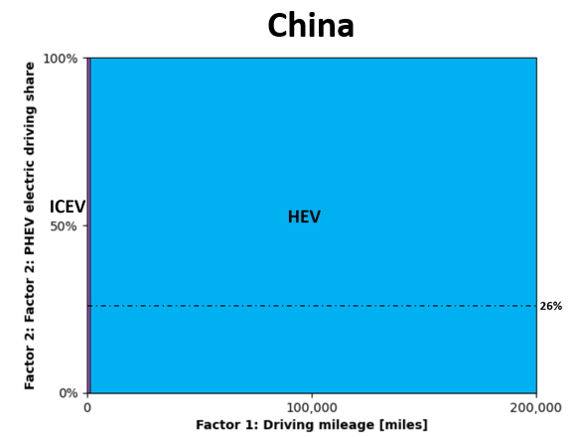
LCA of light-duty vehicles
Global Warming
BEVs and PHEVs make more or less sense depending on:
  the country in which they are located
  the electric driving share
Implications for both national policy and individual consumer purchasing decisions

Slide 16
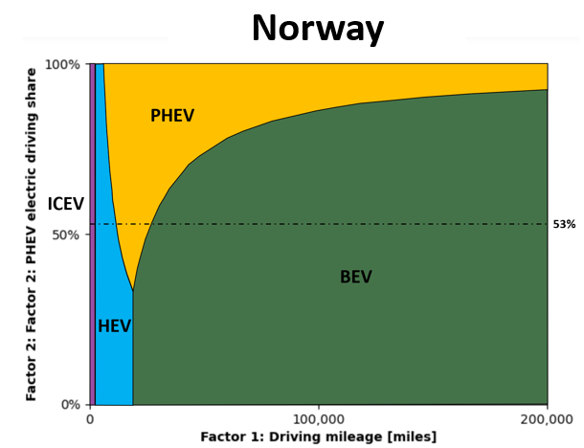
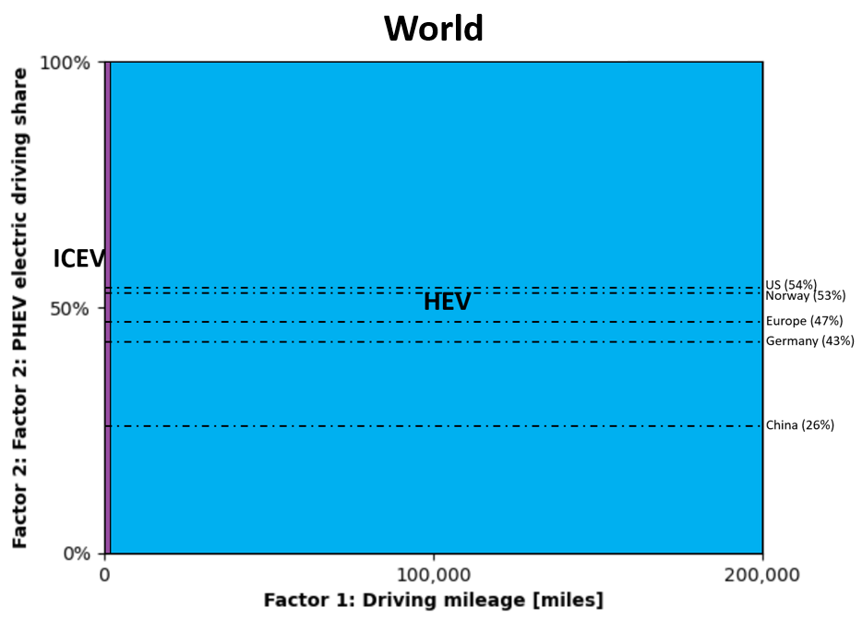
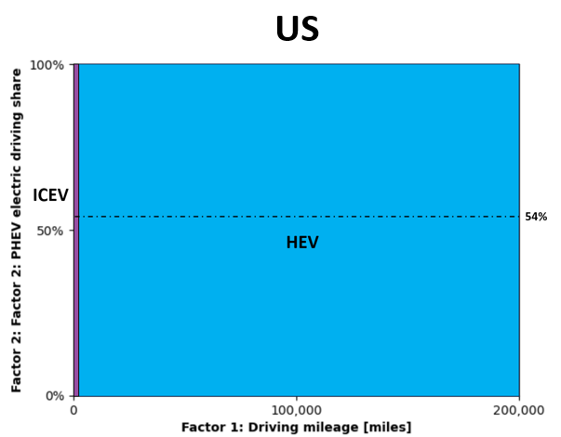
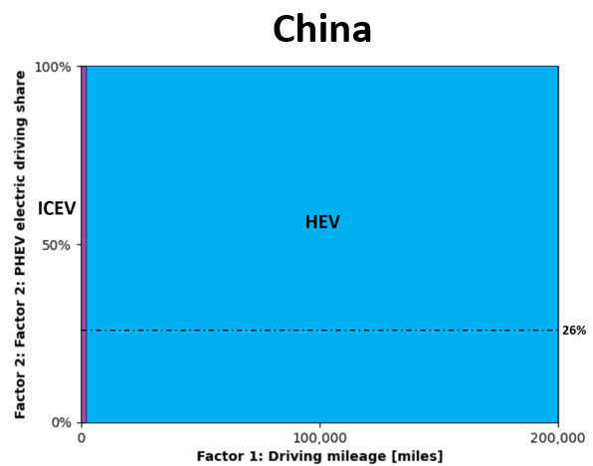
LCA of light-duty vehicles
Respiratory effects
BEVs and PHEVs only make sense in countries with very clean grid
Implications mainly for national policy

Slide 17


Climate resilient agriculture
Advanced treatment technologies
Anaerobic membrane bio-reactor (AnMBR)
Desalination
  Nano-filtration (NF)
  Electro-dialysis (ED)
  Membrane distillation (MD)
  Forward osmosis (FO)
  Reverse osmosis (RO)
Passive stormwater treatment
  Constructed wetland (CW)
  Bioretention cells (BRC)
Unconventional water resources
Municipal wastewater
Brackish groundwater
Estuarine/coastal
Stormwaters
Urban & peri-urban agriculture
Hydroponic
Greenhouses
Rooftop
Controlled environment agriculture (CEA)

Slide 18
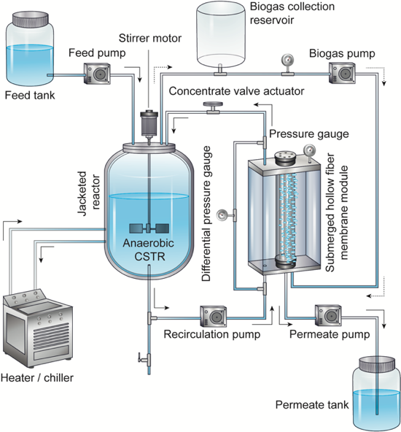
Climate resilient agriculture
Climate Resilient Sustainable Food Production: Controlled Environment Hydroponic Agriculture with Novel Wastewater Treatment & Reuse
The proposed project will integrate an emerging low-cost/-energy municipal wastewater reclamation technology capable of delivering high-quality fertilized irrigation water to a decentralized hydroponic controlled environment agriculture platform for crop cultivation that addresses food safety and microbial risk minimization.
Municipal wastewater
AnMBR
Hydroponic agriculture

Slide 19
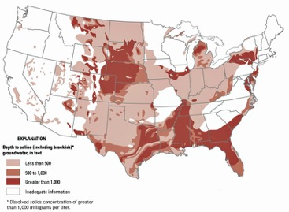
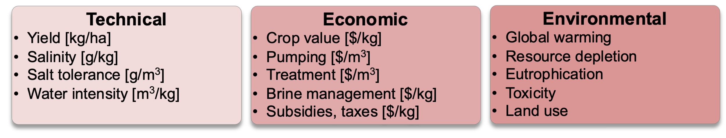
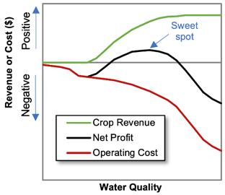
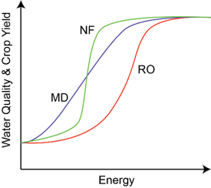
Climate resilient agriculture
Controlled environment agriculture platform for hydroponic cultivation of salt-tolerant Crops with integrated saline water irrigation and salinity management
Our general research objective is to develop an integrated hydroponics contained environment agriculture (CEA) platform for the cultivation of salt-tolerant food crops with saline irrigation waters while enhancing increased salt tolerance in crops, developing new concepts in agricultural-sector desalting technologies, and managing salinity.
Brackish waters
Partial desalting
CEA

Slide 20
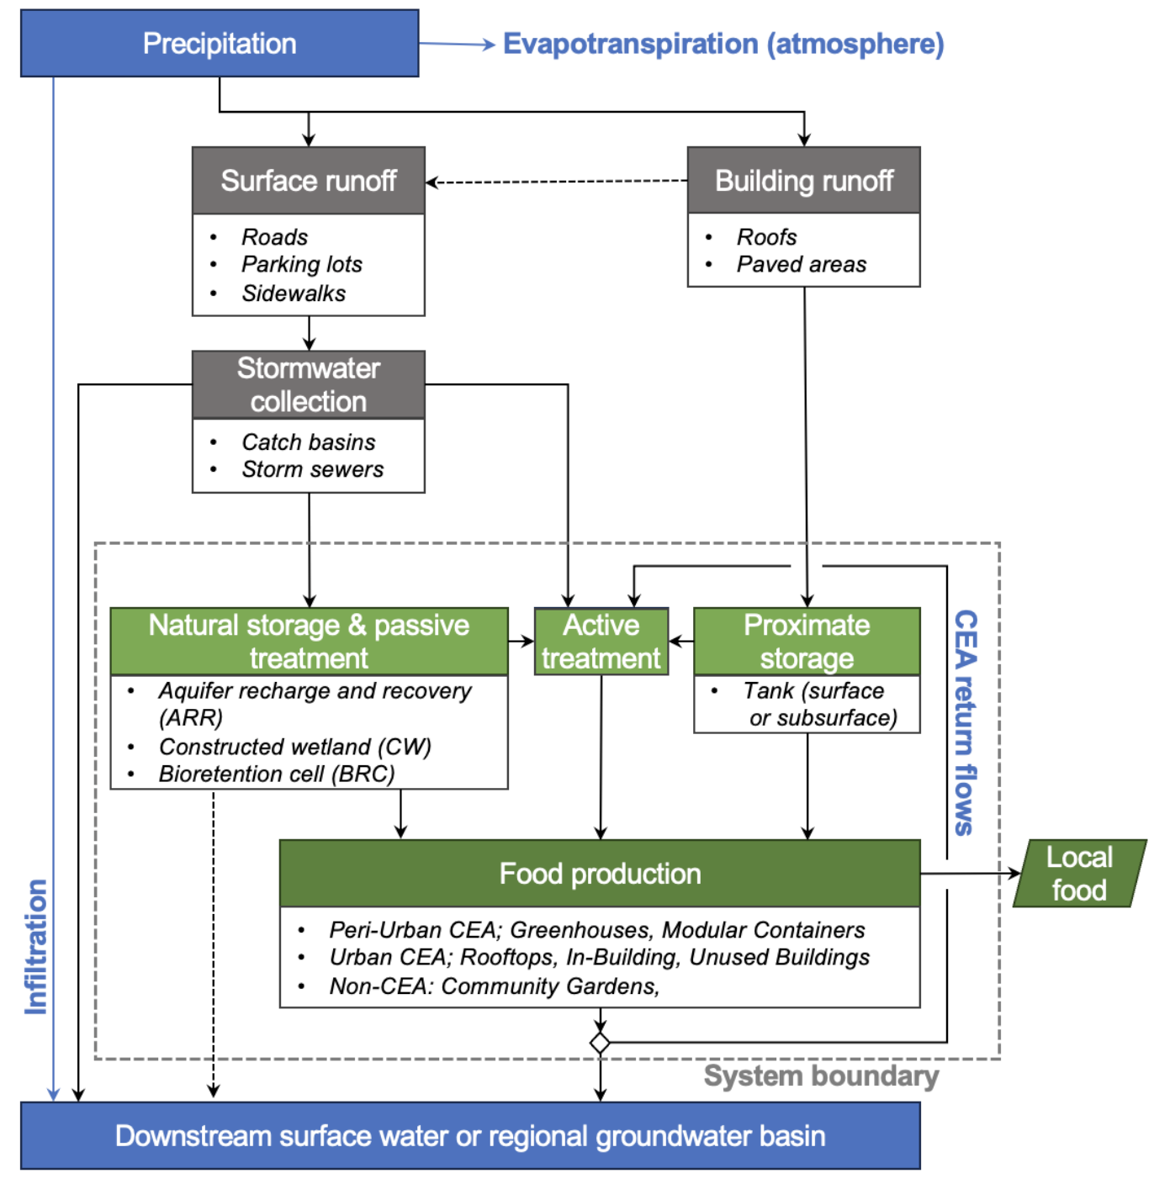
Climate resilient agriculture
Advancing Urban Stormwater as a Non-Conventional Water Resource in Urban Controlled Environment Agriculture
Our goal is to reduce freshwater use in agriculture by utilizing a non-conventional water effectively, economically, and sustainably through creation of a multi-objective framework for deployment of an integrated system of urban stormwater capture, treatment, and storage with utilization by hydroponic CEA for cultivation of high-value food crops in urban and peri-urban communities while reducing urban runoff pollution of downstream receiving waters.
Stormwater
Passive & active
CEA & others

Slide 21

AIM for composites
Artificially Intelligent Manufacturing Paradigm (AIM) for Composites
The mission of this Energy Frontiers Research Center (EFRC), which consists of a multi-disciplinary team of experimentalists, computational researchers and computer scientists, is to build an AI-enabled inverse design approach for fundamental understanding and integrated material-manufacturing design of advanced polymer composites

Slide 22
AIM for composites

Slide 23
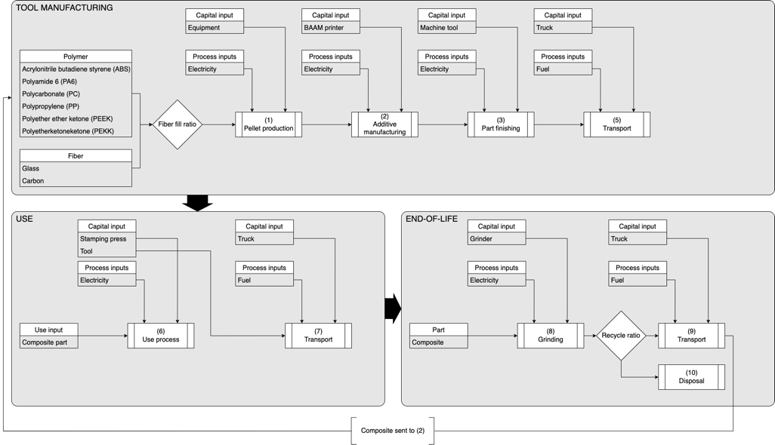
Composites

Slide 24
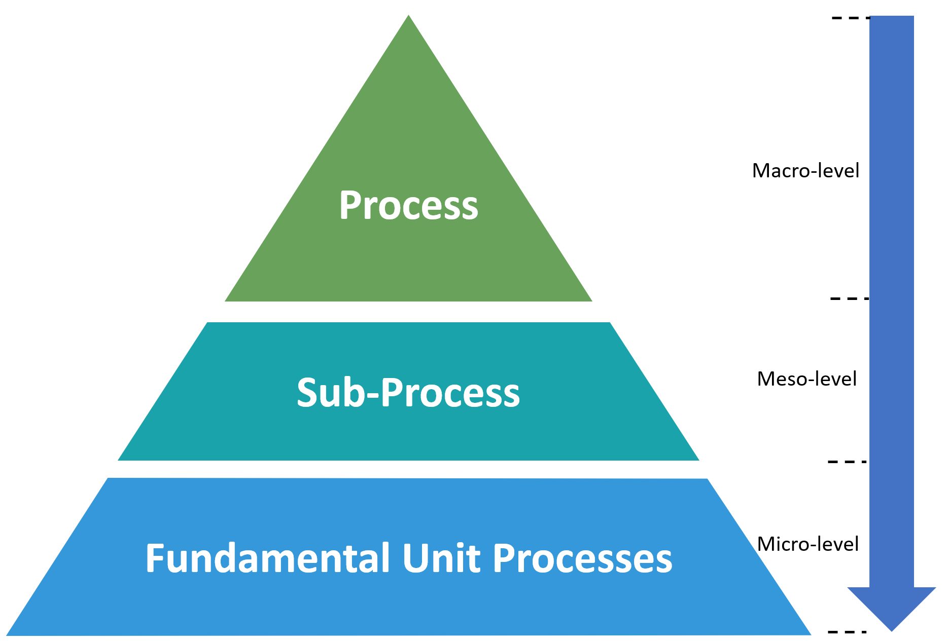
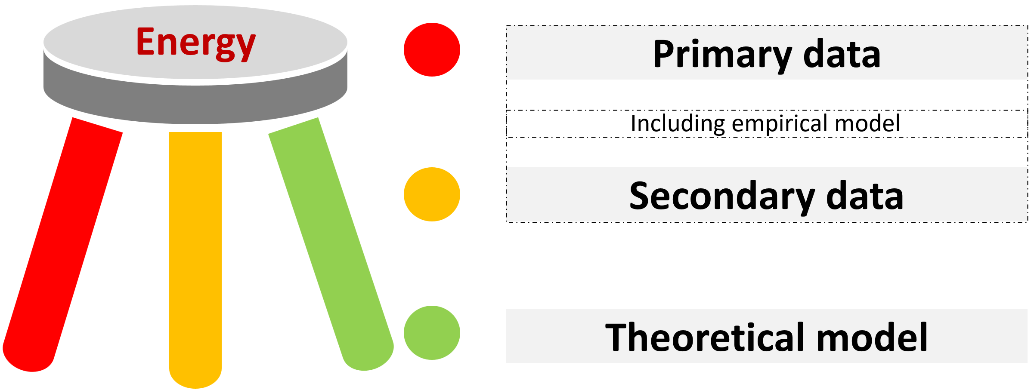
3-tiered, 3-legged approach
Raw material
Emission
Consumables
Product
Energy
Waste/loss

Slide 25
Pellet production

Slide 26
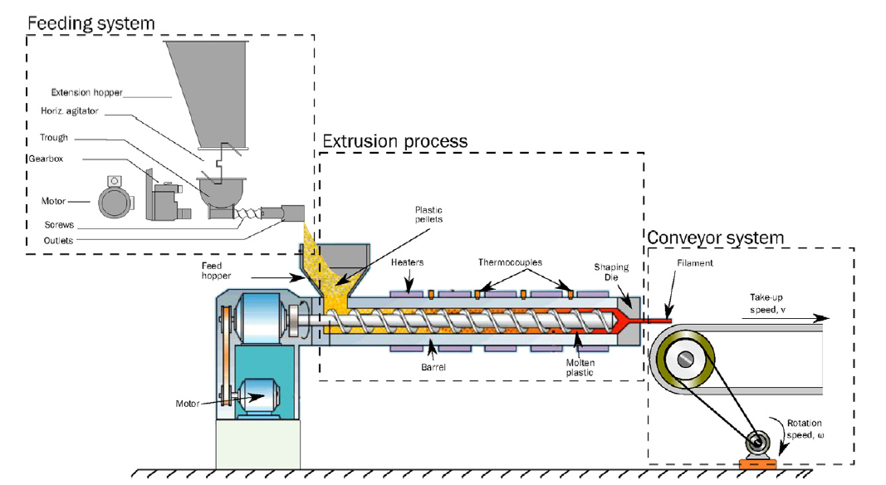
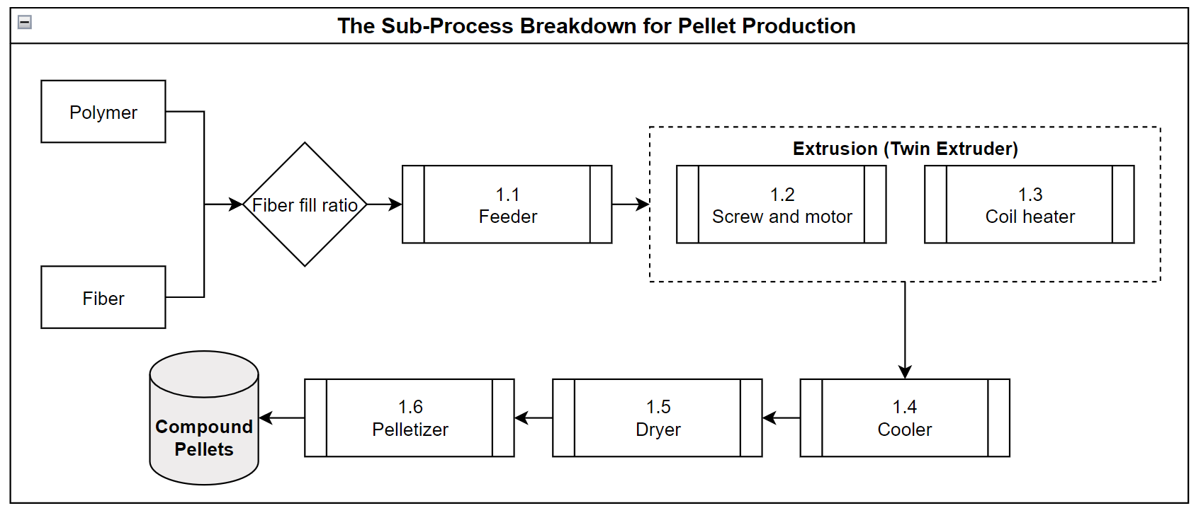
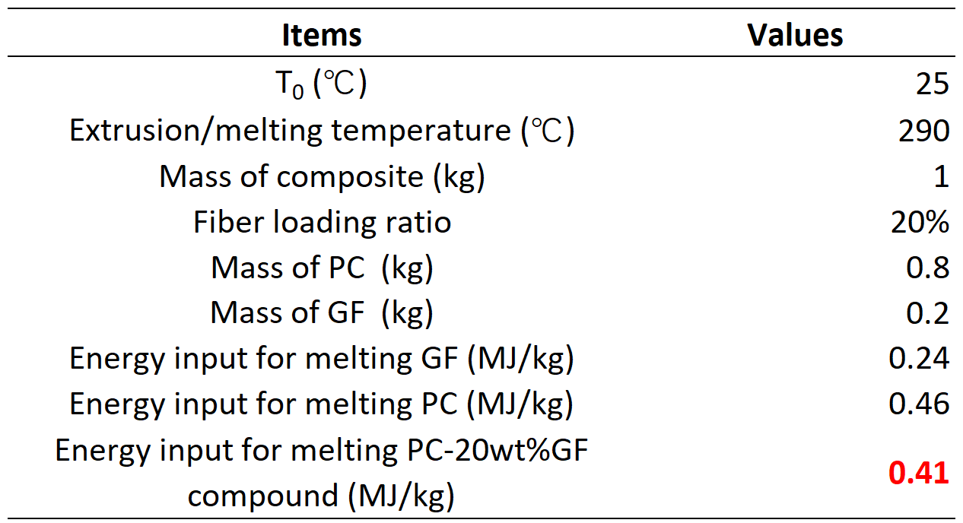


Pellet production
(Picture from: Sanchez et al. 2017)
Theoretical model:
$C_{m}=φC_{fiber}+(1−φ) C_{polymer}$
$$E=C_{m}m(T_{m}−T_{0})$$

Slide 27
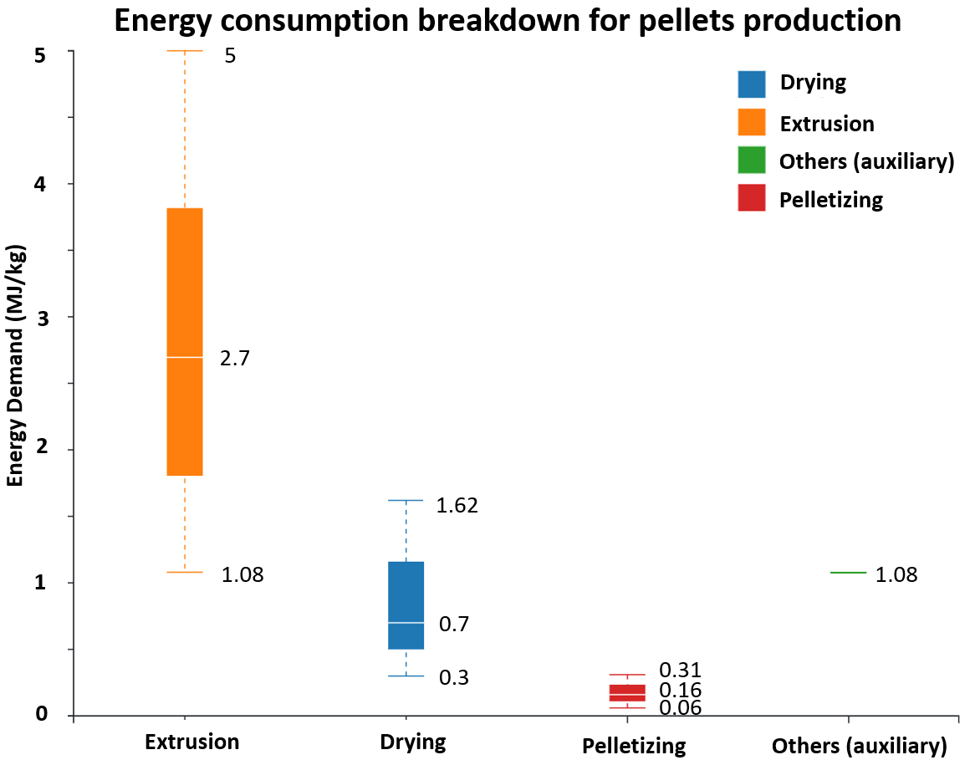
Pellet production
Secondary data
Extrusion is a complex process with few energy consumption models available.
It should be noted that the secondary data for process is presented as a range, not an exact value, due to the influence of various factors.
Extrusion process influential factors:
  Material
  Machine configuration (screw type)
  Process parameter (e.g., screw speed, temperature setting)
  Operator experience
  System boundary
……
1.https://materials.springer.com/
2.https://webbook.nist.gov/
3.Thiriez et al, 2006, An Environmental Analysis of Injection Molding
4.Dormer et al.,2013, Carbon footprint analysis in plastics manufacturing

Slide 28
AIM for composites
Range of energy requirements for different processing technologies
Specific energy requirement [J/kg] decreases as a function of process rate [kg/s]
Typically falls within range of 1-100 kW
Energy requirements at higher process rates are limited by theoretical (thermodynamic) minimum

Slide 29
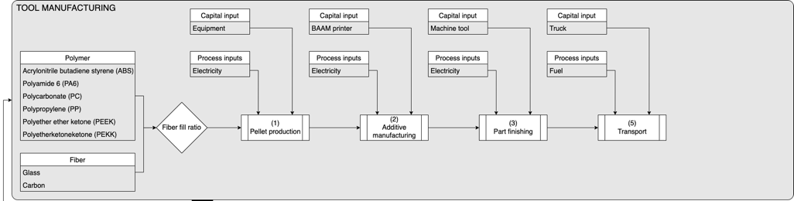
Fundamentally…
Fundamental unit processes are the most basic manipulations of the material, e.g. heating
Depending on the process chain, there may be fundamental unit processes that are common to multiple steps
Are there potential synergies between these tier 1 processes at the fundamental process level?

Slide 30

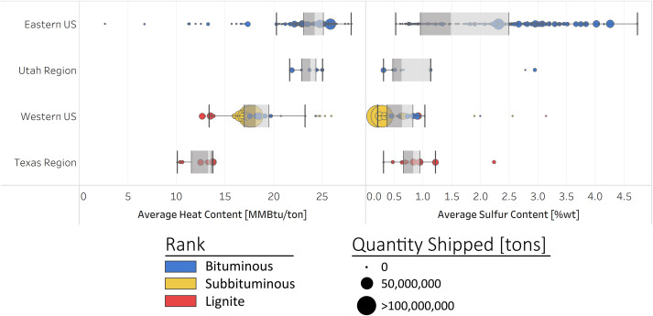
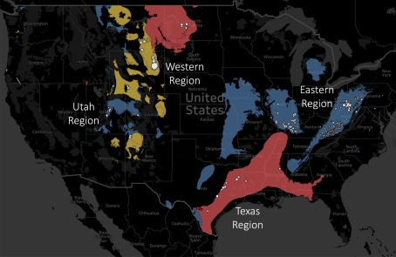
Rolling coal
Eastern coal is higher quality, higher sulfur
Western coal is lower quality, lower sulfur
Sherwood et al. (2020) https://doi.org/10.1016/j.jclepro.2020.120770

Slide 31
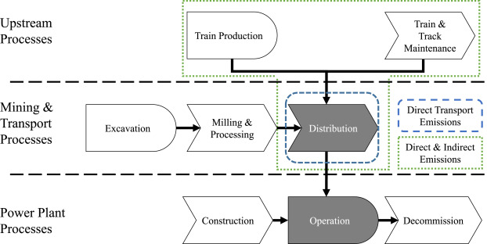
Rolling coal
Sherwood et al. (2020) https://doi.org/10.1016/j.jclepro.2020.120770

Slide 32
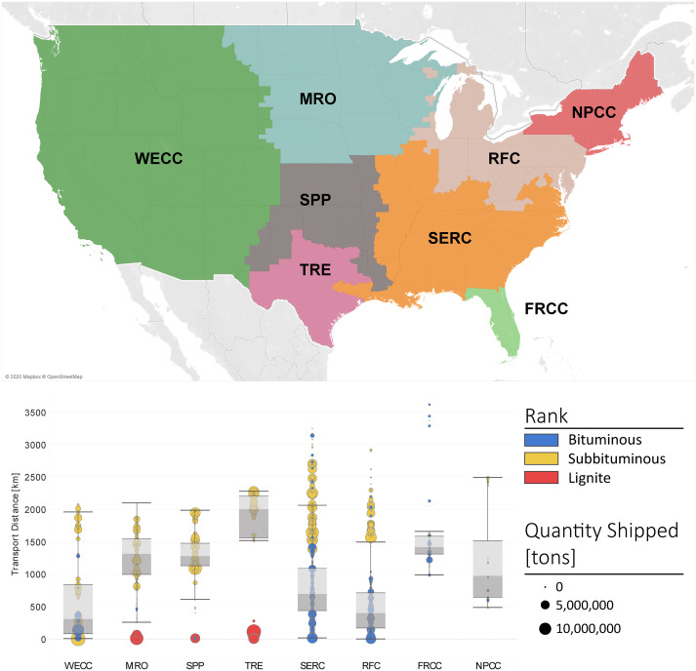
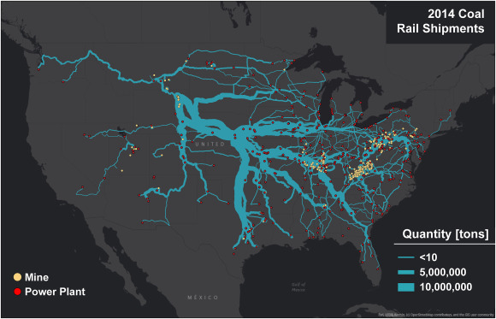
Rolling coal
Sherwood et al. (2020) https://doi.org/10.1016/j.jclepro.2020.120770

Slide 33
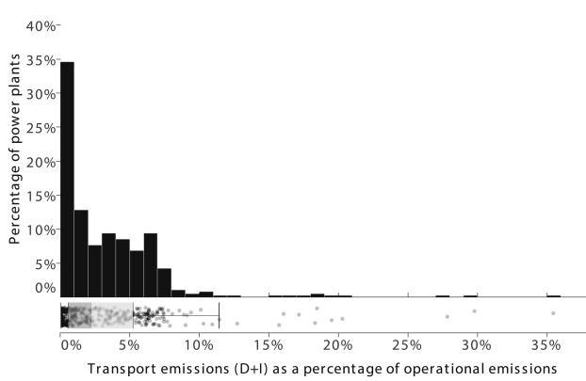
Rolling coal
Median transport emissions are around 3% of operational emissions
Outlier plants have up to 35% of operational emissions due to transport
Carbon capture and sequestration (CCS) will reduce operational emissions at the expense of upstream emissions
Sherwood et al. (2020) https://doi.org/10.1016/j.jclepro.2020.120770

Slide 34
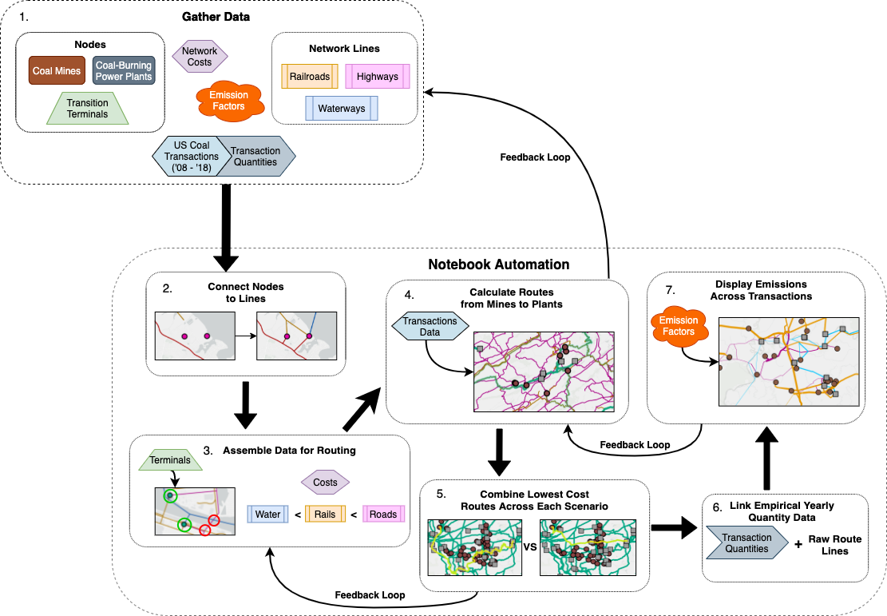
Rolling coal
Moving forward, expand the analysis to include road and water transport
Automate process using Python notebooks inside ArcGIS

Slide 35
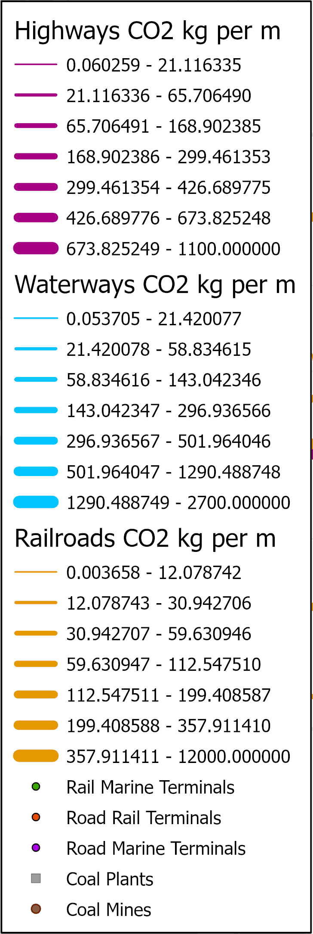
Rolling coal
Network demonstrates risks to resiliency due to high dependence on small number of network edges
Next steps, expand network analysis to include:
  fuel pipelines
  refineries
  electricity transmission

Slide 36
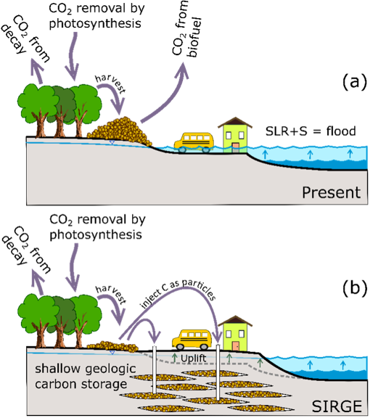
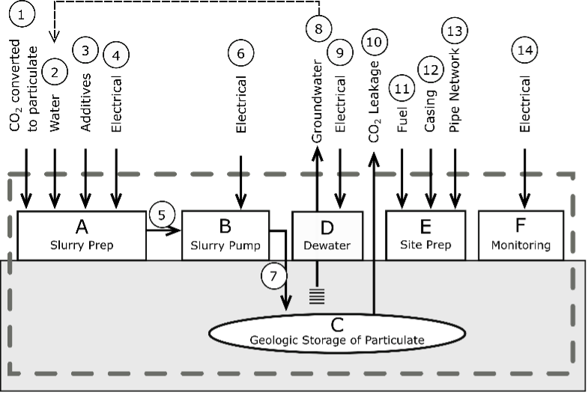
Carbon SIRGE
Shallow Geologic Storage of Carbon to Remove Atmospheric CO₂ and Reduce Flood Risk
We demonstrate the feasibility of injecting solid, carbon-bearing particles into shallow geologic formations at a rate of 15 tonnes of CO₂-eq per hectare per day. The injection process raises the ground surface at a rate of 1.5 mm/day.
These rates upscale to a technique that could mitigate future warming by storing carbon as well as help communities adapt to future flooding risks by lifting the ground surface
Murdoch et al. (2023) https://doi.org/10.1021/acs.est.3c00600

Slide 37
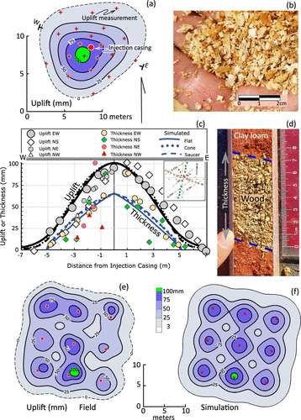
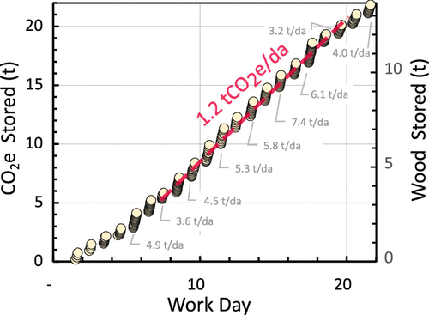
Carbon SIRGE
Climate adaptation – flood protection
Climate mitigation – sequestration
Murdoch et al. (2023) https://doi.org/10.1021/acs.est.3c00600

Slide 38

Carbon SIRGE
Example process flow diagram for Carbon SIRGE.
Numbers are used in the life cycle assessment
Murdoch et al. (2023) https://doi.org/10.1021/acs.est.3c00600

Slide 39
Carbon SIRGE
Net average emission of SIRGE is 3% of the stored carbon
Impact category | Per 2.1 ha site | Per kt CO₂-eq | Units
Acidification potential (AP) | 3.26E-03 | 1.89E-01 | kg SO₂-eq
Human toxicity potential (HTP) - carcinogenic (Carc.) | 1.47E-01 | 8.51E-06 | CTUh
Ecotoxicity potential (ETP) | 5.46E06 | 3.17E02 | CTUe
Eutrophication potential (EP) | 8.70E02 | 5.04E-02 | kg N-eq
Fossil fuel depletion (FFD) | 7.11E05 | 4.12E01 | MJ surplus
Global warming potential (GWP) | 5.49E05 | 3.18E01 | kg CO₂-eq
Human toxicity potential - non carcinogenic (N-Carc.) | 5.84E-02 | 3.38E-06 | CTUh
Ozone depletion potential (ODP) | 7.12E-02 | 4.12E-06 | kg CFC-11-eq
Respiratory effects (Resp.) | 5.79E02 | 3.35E-02 | kg PM_{2.5}-eq
Smog | 9.05E04 | 5.24E00 | kg O₃-eq
Murdoch et al. (2023) https://doi.org/10.1021/acs.est.3c00600

Slide 40

Carbon SIRGE
Normalized impact assessment results using TRACI 2.1 for two-year operation of single location
Murdoch et al. (2023) https://doi.org/10.1021/acs.est.3c00600

Slide 41
Carbon SIRGE
Comparison of SIRGE with other mitigation technique direct air carbon capture and storage (DACCS)
Data for DACCS comes from https://doi.org/10.1021/acs.est.1c03263
SIRGE has (much) lower impact in (most) all categories
Impact category | Impact ratio, SIRGE/DACCS
Human toxicity potential (HTP) - carcinogenic (Carc.) | 0.48
Ecotoxicity potential (ETP) | 0.55
Fossil fuel depletion (FFD) | 0.03
Global warming potential (GWP) | 0.04
Human toxicity potential - non carcinogenic (N-Carc.) | 0.03
Ozone depletion potential (ODP) | 0.05
Murdoch et al. (2023) https://doi.org/10.1021/acs.est.3c00600

Slide 42


Future work…
There seems to be increasing interest in conducting system-level evaluation assessment on different fusion technologies:
magnetic confinement (top) and inertial confinement (bottom)
fuel cycle – production of tritium and target fabrication
reactor construction and maintenance, esp. blanket replacement
Clemson has connected with SRNL on this initiative

Slide 43
Questions?

Slide 44

LCA-Risk
Coupling Life-Cycle Impact Assessment and Risk Assessment for Sustainability-Informed Decision Making
We propose to integrate life cycle impact assessment (LCA) and risk assessment to provide regulatory guidance with respect to key fuel cycle issues, specifically a shifting fuel supply chain and an aging generation of nuclear power reactors.

Slide 45

LCA-Risk
Collaborators:
Lindsay Shuller-Nickles, Associate Professor, Environmental Eng.
Nicole Martinez, Associate Professor, Environmental Eng.
Bryanna Wattier, PhD Candidate, Environmental Eng.

Slide 46





LCA-Risk
Compare environmental impacts of four concrete options for radiological protection:

