Slide 1


The moral and environmental implications of human space travel
Mik Carbajales-Dale
Energy-Economy-Environment (E3) Systems Analysis

Slide 2

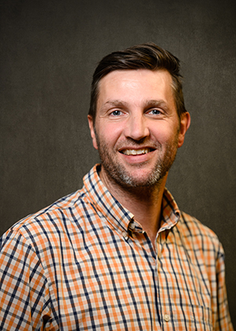
About me
Mik Carbajales-Dale heads the E3 Systems Analysis group.
Associate Professor in Environmental Engineering at Clemson University
Energy Systems Analyst at Stanford University with the Global Climate & Energy Project (GCEP)
Ph.D. in Mechanical Engineering with the Advanced Energy and Material Systems (AEMS) Laboratory at the University of Canterbury, New Zealand
PI/Co-PI on over $30M of funding from Dept. of Energy, National Science Foundation, NASA, US Dept. of Agriculture
Over fifty peer-reviewed publications which have received over 2800 citations, h-index of 28
Chief Editor of Frontiers in Energy Research, Sustainable Energy Systems section
Co-chair of SETAC/ACLCA Working Group on LCA for Emerging Technologies

Slide 3
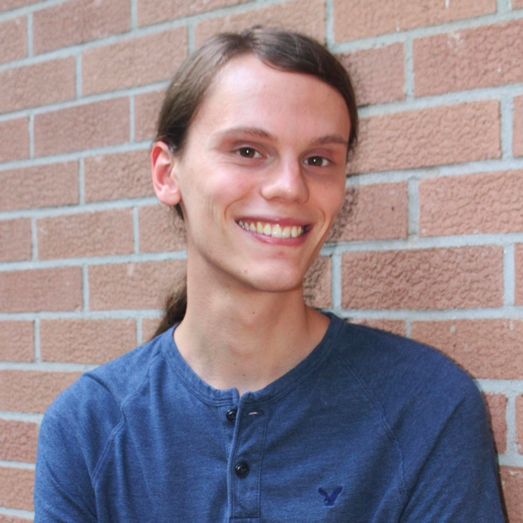




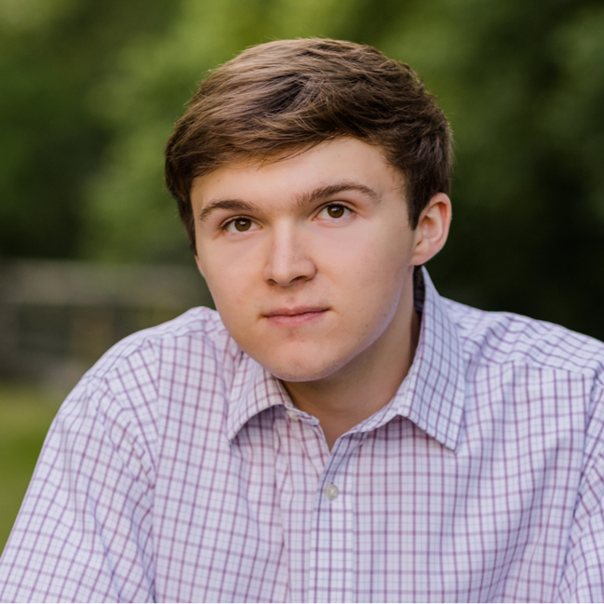


The team
Jacob Arnold
PhD Candidate
Resilient infrastructure
Elif Can
Research Associate
Critical minerals
Hao Chen
PhD Candidate
Advanced manufacturing
Muzan Ijeoma
PhD candidate
Net-negative buildings
Shohreh Kamyab
PhD Candidate
Sustainable agriculture
Garrett Lewis
BS Candidate
Solar PV in Nigeria
Harish Srinivasan
MS Candidate
Wastewater treatment
Cole Van Emburg
BS Candidate
Light duty vehicles

Slide 4









What we do
Macro:
National/global scale: we use geographic information systems (GIS) to assess the availability and suitability of resources and infrastructure and environmentally-extended input-output (EEIO) to represent the structure of economies and understand necessary changes for transition
GIS
EEIO
Meso:
Industry scale: techniques include material flow analysis (MFA), network analysis (NA), agent-based modeling (ABM), and systems dynamics (SD) to explore issues related to technology development and investment management strategies in the face of resource constraints
MFA
NA
ABM
SD
SD
ABM
Micro:
Device/facility scale: building engineering-based bottom-up life cycle assessment (LCA) models to generate rigorous estimates of environmental impacts as well as techno-economic analysis (TEA) models to evaluate financial costs
LCA
TEA

Slide 6
Graphical overview
Carbajales-Dale & Murphy (2022) https://doi.org/10.1016/j.scitotenv.2022.159222

Slide 7
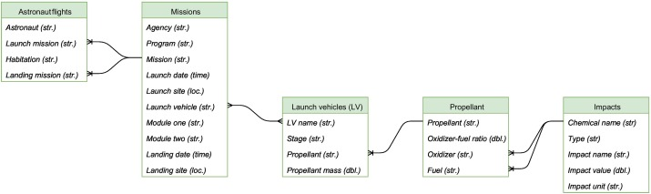
Data structure
Carbajales-Dale & Murphy (2022) https://doi.org/10.1016/j.scitotenv.2022.159222

Slide 8
Human space programs
Agency | Program | Datesª | Launchesª
USAF/NASA^{b} | X-15 | 1959-1968 | 336
NASA | Mercury | 1959-1963 | 26
SSSR^{c} | Vostok | 1960-1964 | 11
SSSR | Voskhod | 1964-1965 | 5
NASA | Gemini | 1965-1966 | 12
NASA | Apollo | 1961-1975 | 33
SSSR/Roscosmos^{d} | Soyuz | 1967- | 174
SSSR | Salyut | 1971-1982 | 6
NASA | Space Shuttle | 1972-2011 | 135
NASA | Skylab | 1973-1974 | 4
SSSR/Roscosmos | Progress^{e} | 1978- | 167
Agency | Program | Datesª | Launchesª
Roscosmos/NASA | Zarya^{f} | 1998 | 1
Roscosmos | Zvezda^{f} | 2000 | 1
CNSA^{g} | Shenzhou | 2001- | 9
ESA^{h} | ATV^{i} | 2008-2014 | 5
JAXA^{j} | Kounotori^{e} | 2009- | 9
Northrop Grumman | CRS^{k} | 2013- | 16
SpaceX | CRS^{k} | 2012- | 24
SpaceX | Crew Dragon | 2015- | 6
Blue Origin | New Shepard | 2011- | 18
SpaceX | Inspiration | 2021- | 1
TOTAL | 21 | 1959- | 981
Carbajales-Dale & Murphy (2022) https://doi.org/10.1016/j.scitotenv.2022.159222
Notes:
Notes:
a: Dates and number includes test and resupply launches
b: United States Air Force (USAF), National Aeronautics and Space Administration (NASA)
c:Soviet Union space agency
d: Russian space agency
e: Uncrewed supply missions
f: ISS module
g: Chinese National Space Agency
h: European Space Agency
i: Automated Transfer Vehicle
j: Japanese Aerospace Exploration Agency
k: Commercial Resupply Service

Slide 9
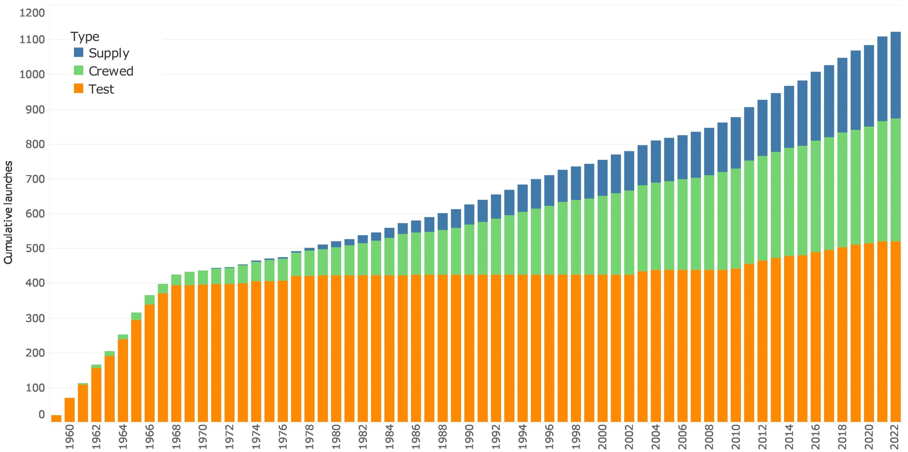
Human space missions
Carbajales-Dale & Murphy (2022) https://doi.org/10.1016/j.scitotenv.2022.159222
Notes:
Cumulative launches by all agencies by year of launch, colored by launch type: test; crewed; or supply
Only missions that passed the Kármán line count as crewed missions

Slide 10
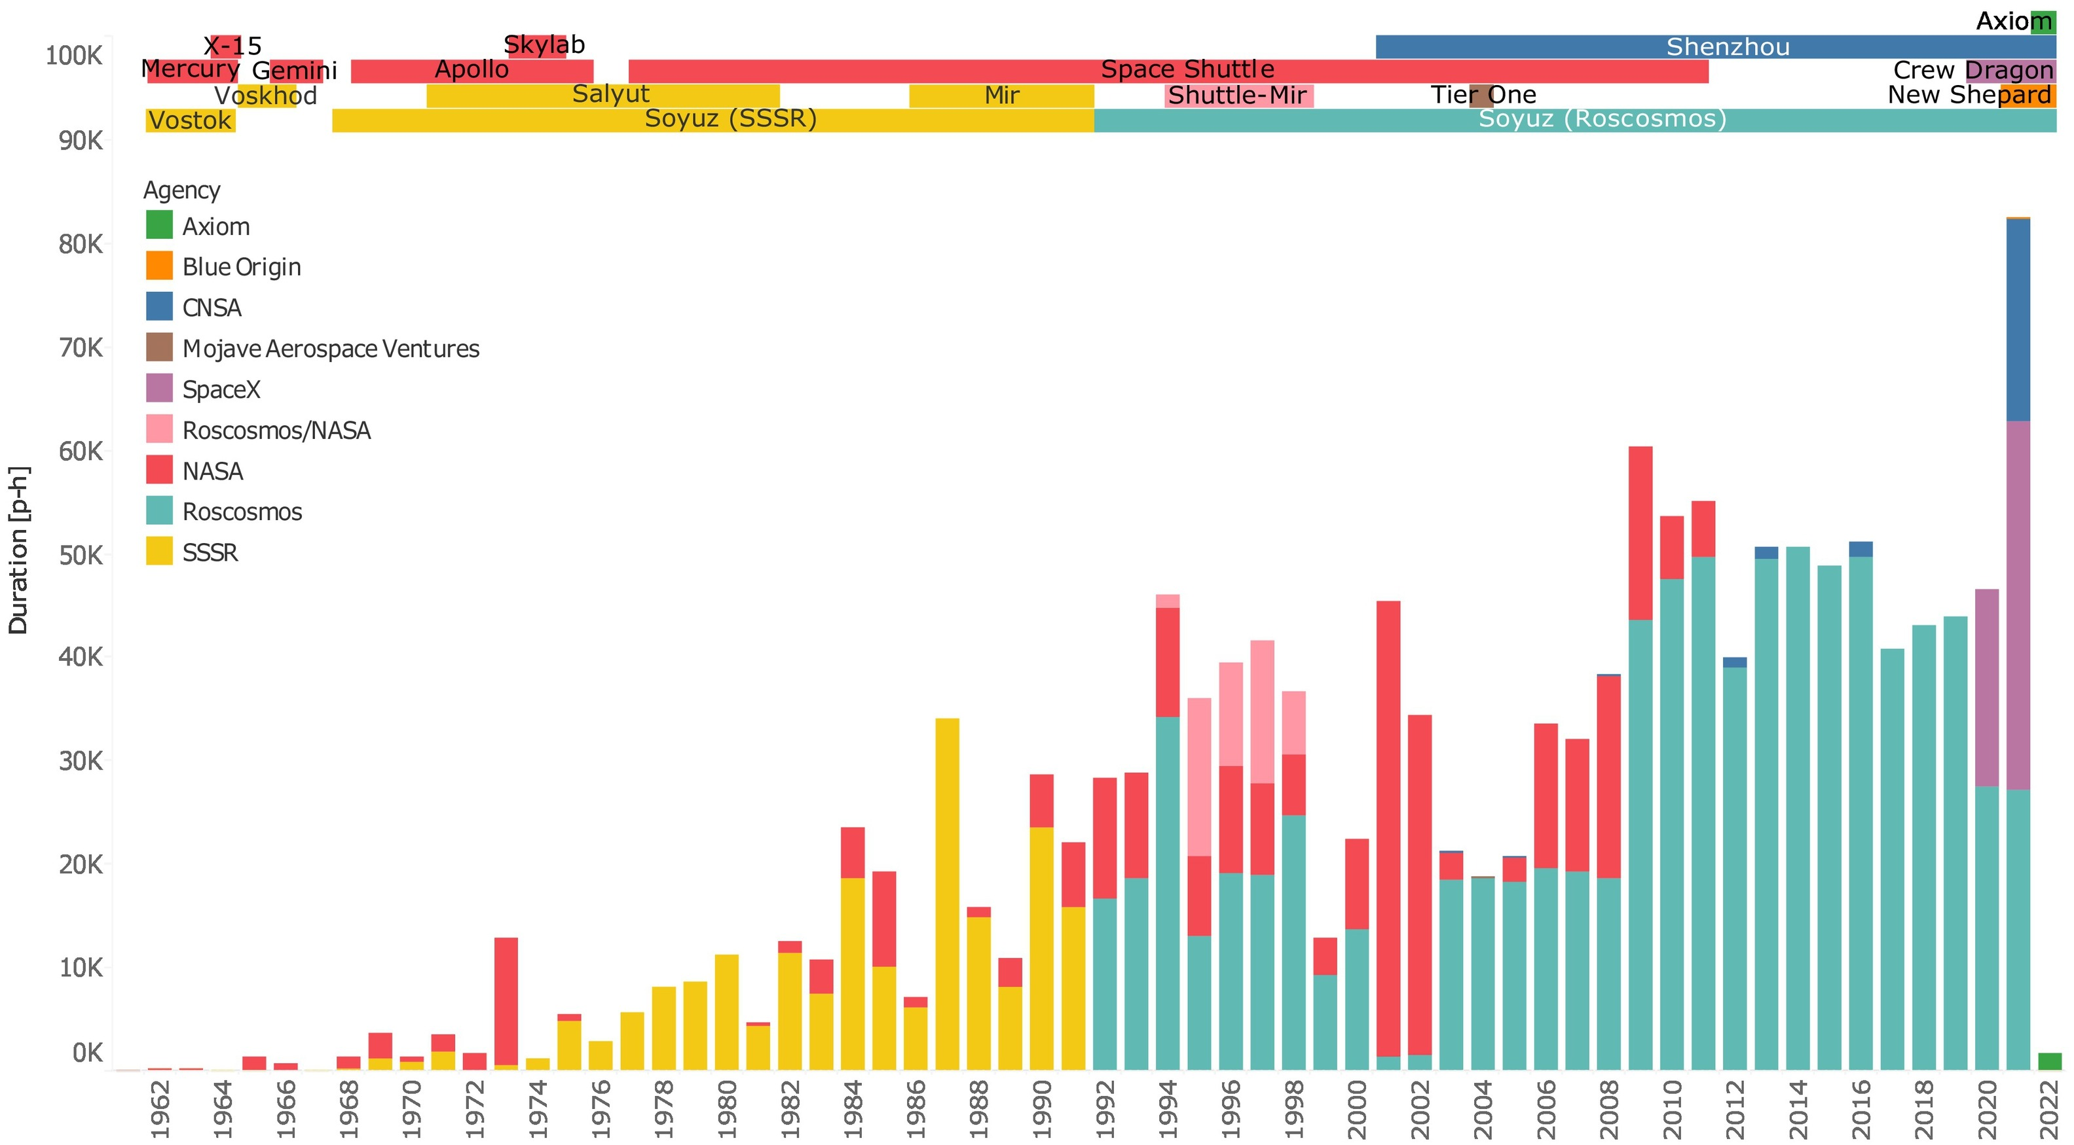
Mission duration
The general trend in space duration has been increasing, with some years more or less
Carbajales-Dale & Murphy (2022) https://doi.org/10.1016/j.scitotenv.2022.159222
Notes:
Duration in space in person-hours by year of launch, colored by launch agency.
Crewed human space programs are listed along the top of the image by the years in which they operated

Slide 11
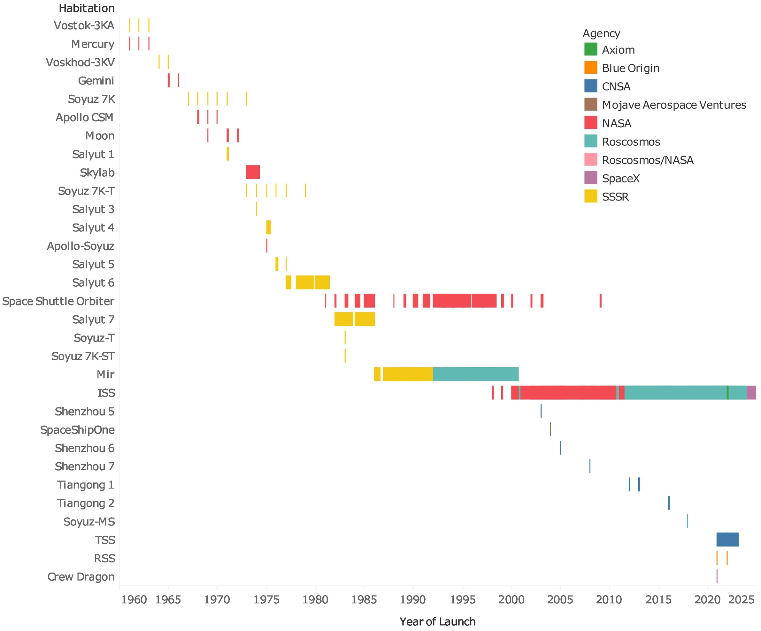
Habitat duration
Since the 1970s, humans have been spending increasing amounts of time in space
Most time has been spent on ISS, which has seen continuous occupation since 2000
Carbajales-Dale & Murphy (2022) https://doi.org/10.1016/j.scitotenv.2022.159222
Notes:
Propellant mass [kg] of launch vehicles vs. their payload capacity [kg] to LEO.
The size of the bubbles represents the launch vehicle empty mass.
The equation of the trendline is $1187x^{0.623}$ and has an R-squared value of 0.96

Slide 12
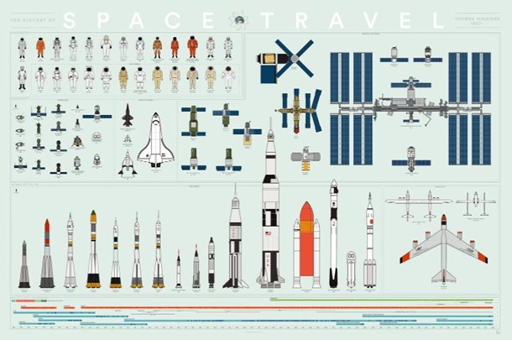
Launch vehicles & spacecraft
https://myscienceshop.com/product/poster/82044

Slide 13
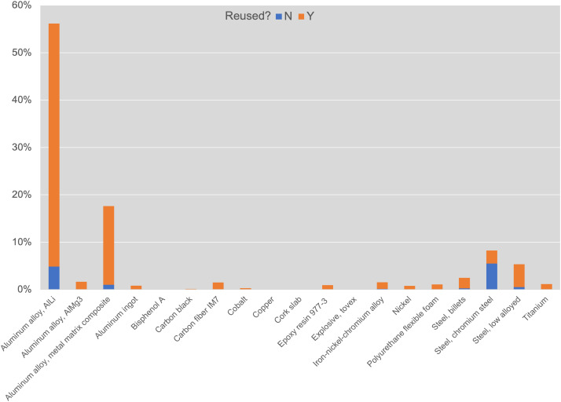
Launch vehicle materials
(re)use
Mass percentage of different materials used in launch vehicles
Carbajales-Dale & Murphy (2022) https://doi.org/10.1016/j.scitotenv.2022.159222
Notes:
Notes:
ª Oxidizer-to-fuel ratio, by mass
^{b} Liquid oxygen
^{c} Refined Petroleum-1, a.k.a. kerosene
^{d} Liquid hydrogen
^{e} (Di)nitrogen tetroxide
^{f} Aerosene-50
^{g} Unsymmetrical dimethylhydrazine
^{h} Monomethylhydrazine
^{i} Ammonium perchlorate
^{j} Aluminum (Al) fuel in polybutadiene acrylonitrile (PBAN) or hydroxyl-terminated polydbutadiene (HTPB) binder
^{k} Liquid nitrous oxide
^{l} Red fuming nitric acid

Slide 14
Propellants
Propellant | Solid/liquid | Oxidizer | Fuel | O/F ratioª | CO emission
Air-RP1 | Liquid | Air | Kerosene | 58.82 | 0%
LOX-alcohol | Liquid | LOX^{b} | Ethyl alcohol | 1.80 | 8%
LOX-RP1^{c} | Liquid | LOX | Kerosene | 2.56 | 39%
LOX-LH2 | Liquid | LOX | LH2^{d} | 6.00 | 0%
LOX-ammonia | Liquid | LOX | Ammonia | 1.40 | 0%
NTO-A50 | Liquid | NTO^{e} | A50^{f} | 1.34 | 17%
NTO-UMDH | Liquid | NTO | UMDH^{g} | 2.61 | 15%
NTO-MMH | Liquid | NTO | MMH^{h} | 2.16 | 11%
AP-Al/PBAN | Solid | AP^{i} | Al/PBAN^{j} | 2.49 | 23%
Solid: AP-Al/HTPB | Solid | AP | Al/HTPB^{j} | 2.13 | 23%
LNO-HTPB | Liquid | LNO^{k} | HTPB | 6.00 | 19%
RFNA-amine | Liquid | RFNA^{l} | Amine | 3.20 | 28%
Carbajales-Dale & Murphy (2022) https://doi.org/10.1016/j.scitotenv.2022.159222
Notes:
Notes:
ª Oxidizer-to-fuel ratio, by mass
^{b} Liquid oxygen
^{c} Refined Petroleum-1, a.k.a. kerosene
^{d} Liquid hydrogen
^{e} (Di)nitrogen tetroxide
^{f} Aerosene-50
^{g} Unsymmetrical dimethylhydrazine
^{h} Monomethylhydrazine
^{i} Ammonium perchlorate
^{j} Aluminum (Al) fuel in polybutadiene acrylonitrile (PBAN) or hydroxyl-terminated polydbutadiene (HTPB) binder
^{k} Liquid nitrous oxide
^{l} Red fuming nitric acid

Slide 15
Launch vehicles
Launch vehicle | Stagesª | Propellant | Payload to LEO^{b} | Empty mass [kg] | Fueled mass [kg]
Vostok-K | 3 | LOX-RP1 | 4730 | 23,080 | 280,175
Mercury-Redstone | 1 | LOX-Alcohol | 1,800^{c} | 13,258 | 23,270
Atlas LV-3B | 2 | LOX-RP1 | 1360 | 6100 | 110,000
NB-52 | 1 | Air-RP1 | 25,000^{d} | 70,550 | 177,300
Voskhod 11A57 | 3 | LOX-RP1 | 5900 | 24,000 | 298,400
Titan II | 2 | NTO-A50 | 3600 | 9150 | 146,800
Soyuz | 3 | LOX-RP1 | 6450 | 23,400 | 274,500
Soyuz-U | 3 | LOX-RP1 | 6700 | 24,450 | 274,500
Saturn IB | 2 | LOX-RP1 + LOX-LH2 | 18,600 | 54,500 | 567,500
Saturn V | 3 | LOX-RP1 + LOX-LH2 | 120,000 | 187,500 | 2,895,000
Carbajales-Dale & Murphy (2022) https://doi.org/10.1016/j.scitotenv.2022.159222
Notes:
Notes:
ª Including boosters
^{b} Low Earth orbit, an altitude of 160-2000 km, unless stated
^{c} Sub-orbital
^{d} To an altitude of 11.5 km
^{e} a.k.a. Space Transport System
^{f} Including mass of Space Shuttle Orbiter
^{g} To an altitude of 16 km
^{h} Average of Antares 110, 120, 130, 230, and 230+
^{I} To an altitude of 21 km
^{j} To an altitude of 110 km

Slide 16
Launch vehicles
Launch vehicle | Stagesª | Propellant | Payload to LEO^{b} | Empty mass [kg] | Fueled mass [kg]
Space Shuttle^{e} | 2 | AP-Al/PBAN+LOX-LH2 | 102,500^{f} | 202,300 | 1,930,300
Soyuz-U2 | 3 | LOX-RP1 | 7,050 | 23,100 | 297,800
Soyuz-FG | 3 | LOX-RP1 | 6,900 | 24,500 | 308,000
Long March 2F | 3 | NTO-UDMH | 8,400 | 27,800 | 452,000
Falcon 9 | 2 | LOX-RP1 | 22,800 | 29,500 | 517,900
White Knight | 1 | Air-RP1 | 3,200^{g} | 2,900 | 5,800
H-IIB | 3 | AP-Al/HTPB+LOX-LH2 | 19,000 | 69,600 | 528,000
Antares^{h} | 2 | LOX-RP1+AP-AL/HTPB | 8,000 | 39,000 | 280,900
Ariane 5ES | 3 | AP-Al/HTPB+LOX-LH2+NTO-MMH | 21,000 | 91,900 | 755,400
Carbajales-Dale & Murphy (2022) https://doi.org/10.1016/j.scitotenv.2022.159222
Notes:
Notes:
ª Including boosters
^{b} Low Earth orbit, an altitude of 160-2000 km, unless stated
^{c} Sub-orbital
^{d} To an altitude of 11.5 km
^{e} a.k.a. Space Transport System
^{f} Including mass of Space Shuttle Orbiter
^{g} To an altitude of 16 km
^{h} Average of Antares 110, 120, 130, 230, and 230+
^{I} To an altitude of 21 km
^{j} To an altitude of 110 km

Slide 17
Launch vehicles
Launch vehicle | Stagesª | Propellant | Payload to LEO^{b} | Empty mass [kg] | Fueled mass [kg]
Soyuz 2.1a | 3 | LOX-RP1 | 7,800 | 24,500 | 308,200
Proton-K | 3 | NTO-UDMH | 19,760 | 47,000 | 669,100
Vostok-L | 3 | LOX-RP1 | 4,550 | 23,200 | 277,700
White Knight Two | 1 | Air-RP1 | 17,000^{i} | 8,800 | 18,600
New Shepard | 1 | LOX-LH2 | 5,400^{j} | 13,600 | 40,800
Atlas V 401 | 2 | LOX-RP1+LOX-LH2 | 9,800 | 23,400 | 328,300
Atlas V 501 | 2 | LOX-RP1+LOX-LH2 | 8,100 | 23,400 | 328,300
Atlas V N22 | 3 | AP-Al/PBAN+LOX-RP1+LOX-LH2 | 13,000 | 31,500 | 421,700
Carbajales-Dale & Murphy (2022) https://doi.org/10.1016/j.scitotenv.2022.159222
Notes:
Notes:
ª Including boosters
^{b} Low Earth orbit, an altitude of 160-2000 km, unless stated
^{c} Sub-orbital
^{d} To an altitude of 11.5 km
^{e} a.k.a. Space Transport System
^{f} Including mass of Space Shuttle Orbiter
^{g} To an altitude of 16 km
^{h} Average of Antares 110, 120, 130, 230, and 230+
^{I} To an altitude of 21 km
^{j} To an altitude of 110 km

Slide 18
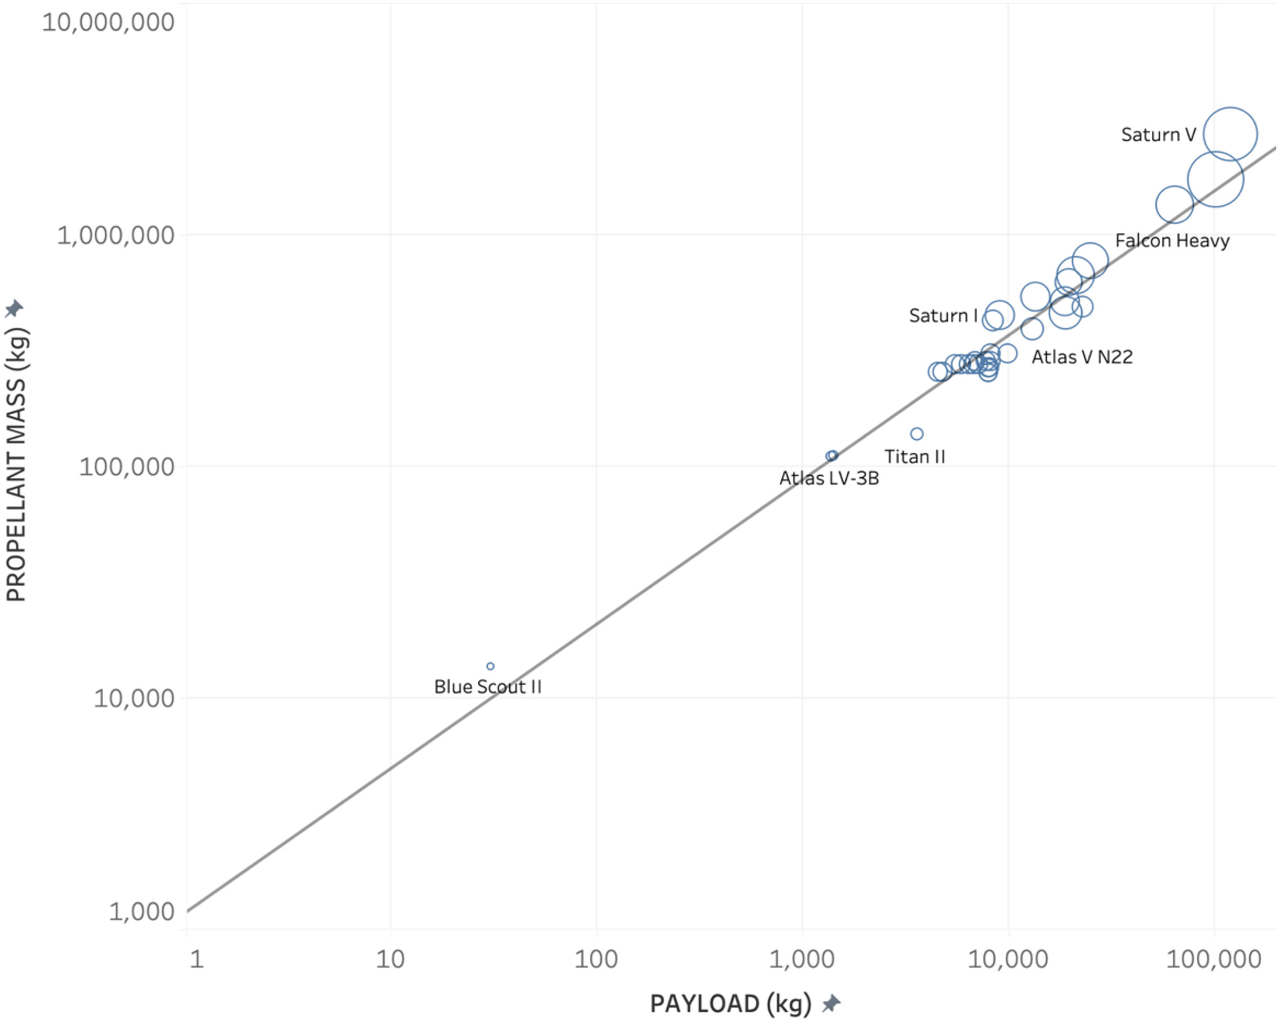
Launch vehicles
Propellant mass increases as a power function of payload to LEO
1 kg to LEO requires 1200 kg of propellant
1000 kg requires 88,000 kg
Payload to trans-lunar injection requires 2.8 times LEO requirement
Payload to Mars transfer orbit (MTO) requires 3.6 times LEO requirement
Carbajales-Dale & Murphy (2022) https://doi.org/10.1016/j.scitotenv.2022.159222
Notes:
Propellant mass [kg] of launch vehicles vs. their payload capacity [kg] to LEO.
The size of the bubbles represents the launch vehicle empty mass.
The equation of the trendline is $1187x^{0.623}$ and has an R-squared value of 0.96

Slide 19
Environmental impact categories
TRACI midpoint impact categories:
acidification [kg SO₂-eq],
carcinogenics [CTUh],
ecotoxicity [CTUe],
eutrophication [kg N-eq],
fossil fuel depletion [MJ surplus],
global warming [kg CO₂-eq],
non-carcinogenics [CTUh],
ozone depletion [CFC-11-eq],
respiratory effects [kg PM2.5-eq], and
smog [kg O₃-eq]
LV materials
Prop. manufacture
Prop. combustion
Carbajales-Dale & Murphy (2022) https://doi.org/10.1016/j.scitotenv.2022.159222
Notes:
Base-case impacts for a single launch for all of the launch vehicles across the TRACI impact categories
Colored by impact type:
launch vehicle in blue,
propellant production in red, and
propellant combustion in orange.
Vertical axes vary based on TRACI midpoint impact categories:
acidification [kg SO₂-eq],
carcinogenics [CTUh], (comparative toxic units for human toxicity),
ecotoxicity [CTUe],
eutrophication [kg N-eq],
fossil fuel depletion [MJ surplus],
global warming [kg CO₂-eq],
non-carcinogenics [CTUh],
ozone depletion [CFC-11-eq],
respiratory effects [kg PM2.5-eq], and
smog [kg O₃-eq].
The dominant impact type varies across impact category.
Space Shuttle has the highest impacts in all categories but ozone depletion.

Slide 20
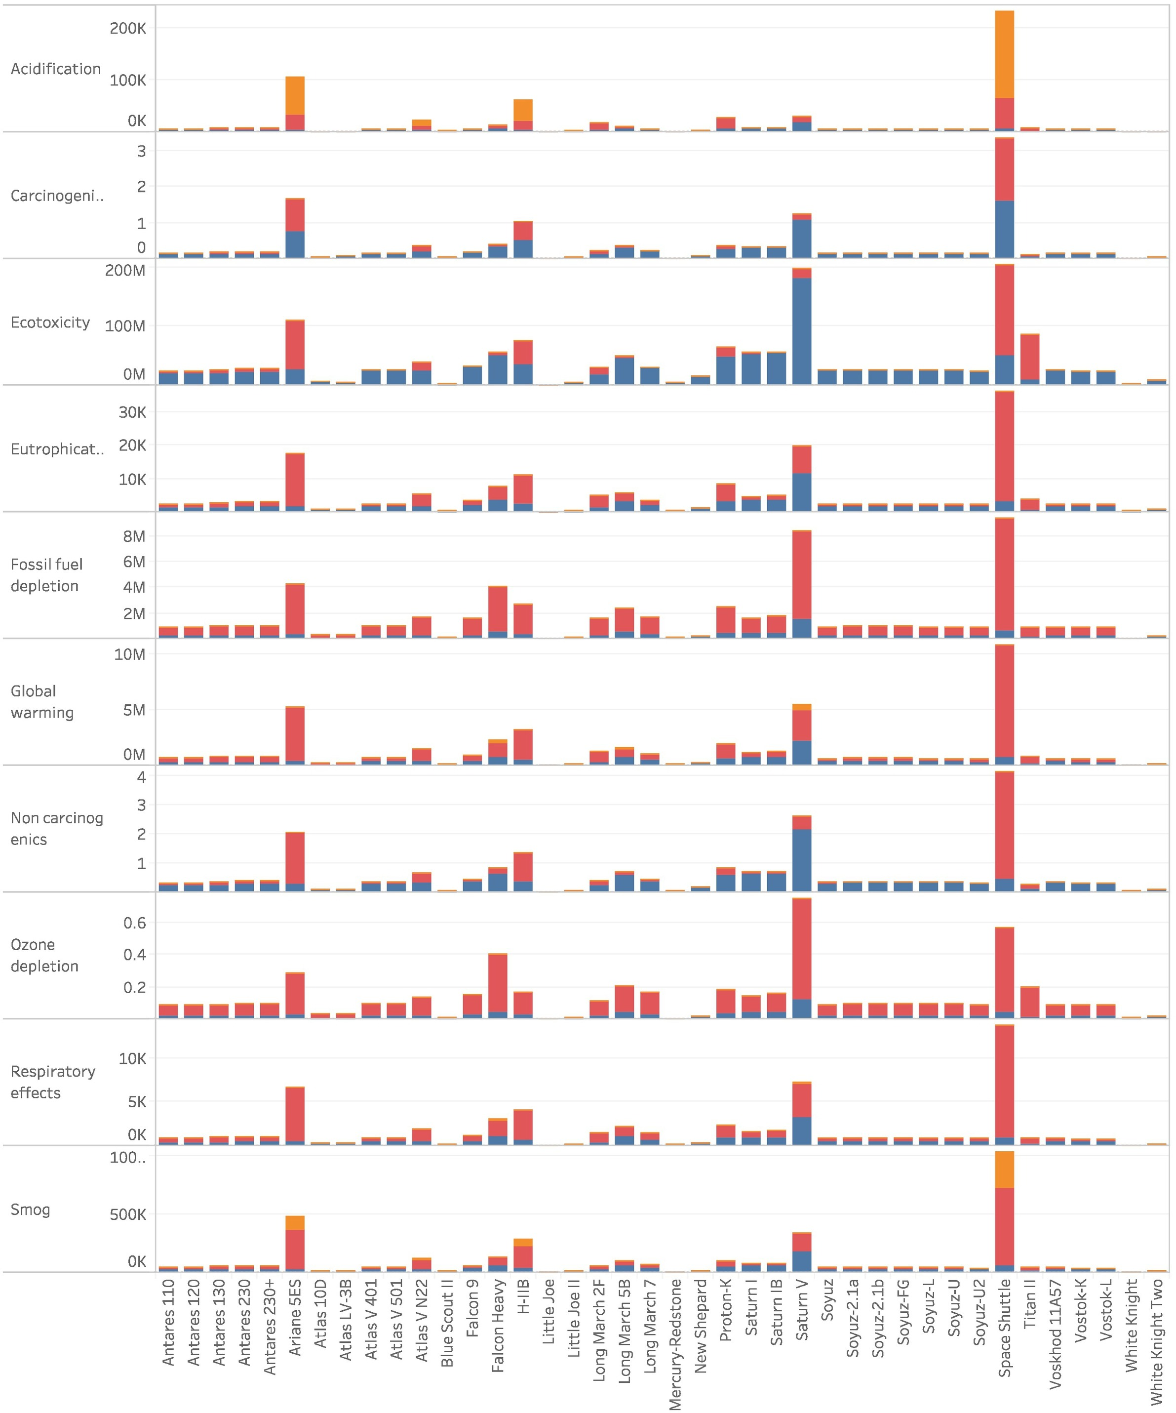
Environmental impacts per launch
Acidification is an unusual case in that most of the impacts come from propellant combustion, whereas for other impact categories,
LV materials
Prop. manufacture
Prop. combustion
Carbajales-Dale & Murphy (2022) https://doi.org/10.1016/j.scitotenv.2022.159222
Notes:
Base-case impacts for a single launch for all of the launch vehicles across the TRACI impact categories
Colored by impact type:
launch vehicle in blue,
propellant production in red, and
propellant combustion in orange.
Vertical axes vary based on TRACI midpoint impact categories:
acidification [kg SO₂-eq],
carcinogenics [CTUh], (comparative toxic units for human toxicity),
ecotoxicity [CTUe],
eutrophication [kg N-eq],
fossil fuel depletion [MJ surplus],
global warming [kg CO₂-eq],
non-carcinogenics [CTUh],
ozone depletion [CFC-11-eq],
respiratory effects [kg PM2.5-eq], and
smog [kg O₃-eq].
The dominant impact type varies across impact category.
Space Shuttle has the highest impacts in all categories but ozone depletion.

Slide 21
Environmental impacts per launch
LV materials
Prop. manufacture
Prop. combustion
Carbajales-Dale & Murphy (2022) https://doi.org/10.1016/j.scitotenv.2022.159222
Notes:
Base-case impacts for a single launch for all of the launch vehicles across the TRACI impact categories
Colored by impact type:
launch vehicle in blue,
propellant production in red, and
propellant combustion in orange.
Vertical axes vary based on TRACI midpoint impact categories:
acidification [kg SO₂-eq],
carcinogenics [CTUh], (comparative toxic units for human toxicity),
ecotoxicity [CTUe],
eutrophication [kg N-eq],
fossil fuel depletion [MJ surplus],
global warming [kg CO₂-eq],
non-carcinogenics [CTUh],
ozone depletion [CFC-11-eq],
respiratory effects [kg PM2.5-eq], and
smog [kg O₃-eq].
The dominant impact type varies across impact category.
Space Shuttle has the highest impacts in all categories but ozone depletion.

Slide 22
Environmental impacts per launch
LV materials
Prop. manufacture
Prop. combustion
Carbajales-Dale & Murphy (2022) https://doi.org/10.1016/j.scitotenv.2022.159222
Notes:
Base-case impacts for a single launch for all of the launch vehicles across the TRACI impact categories
Colored by impact type:
launch vehicle in blue,
propellant production in red, and
propellant combustion in orange.
Vertical axes vary based on TRACI midpoint impact categories:
acidification [kg SO₂-eq],
carcinogenics [CTUh], (comparative toxic units for human toxicity),
ecotoxicity [CTUe],
eutrophication [kg N-eq],
fossil fuel depletion [MJ surplus],
global warming [kg CO₂-eq],
non-carcinogenics [CTUh],
ozone depletion [CFC-11-eq],
respiratory effects [kg PM2.5-eq], and
smog [kg O₃-eq].
The dominant impact type varies across impact category.
Space Shuttle has the highest impacts in all categories but ozone depletion.

Slide 23
Environmental impacts per launch
LV materials
Prop. manufacture
Prop. combustion
Carbajales-Dale & Murphy (2022) https://doi.org/10.1016/j.scitotenv.2022.159222
Notes:
Base-case impacts for a single launch for all of the launch vehicles across the TRACI impact categories
Colored by impact type:
launch vehicle in blue,
propellant production in red, and
propellant combustion in orange.
Vertical axes vary based on TRACI midpoint impact categories:
acidification [kg SO₂-eq],
carcinogenics [CTUh], (comparative toxic units for human toxicity),
ecotoxicity [CTUe],
eutrophication [kg N-eq],
fossil fuel depletion [MJ surplus],
global warming [kg CO₂-eq],
non-carcinogenics [CTUh],
ozone depletion [CFC-11-eq],
respiratory effects [kg PM2.5-eq], and
smog [kg O₃-eq].
The dominant impact type varies across impact category.
Space Shuttle has the highest impacts in all categories but ozone depletion.

Slide 24
Uncertainty scenarios
Scenario | Launch vehicle | Propellant | Propellant manufacture | Propellant combustion | Fueled mass [kg]
 | Buy-to-fly ratio | Fabrication |  | Uncertainty | GWP of carbon monoxide [kg CO₂-eq/kg CO]
Base | 1.0 | None | Equal to ecoinvent | Equal to RPC-A | 0
Low | 1.5 | 50 % base materials | Equal to ecoinvent | Equal to RPC-A | 1
Medium | 5.0 | 100 % base materials | Ecoinvent + 5 % | RPC-A + 2 % | 2
High | 10.0 | 200 % base materials | Ecoinvent + 10 % | RPC-A + 5 % | 3
Carbajales-Dale & Murphy (2022) https://doi.org/10.1016/j.scitotenv.2022.159222
Notes:
Notes:
ª Including boosters
^{b} Low Earth orbit, an altitude of 160-2000 km, unless stated
^{c} Sub-orbital
^{d} To an altitude of 11.5 km
^{e} a.k.a. Space Transport System
^{f} Including mass of Space Shuttle Orbiter
^{g} To an altitude of 16 km
^{h} Average of Antares 110, 120, 130, 230, and 230+
^{I} To an altitude of 21 km
^{j} To an altitude of 110 km

Slide 25
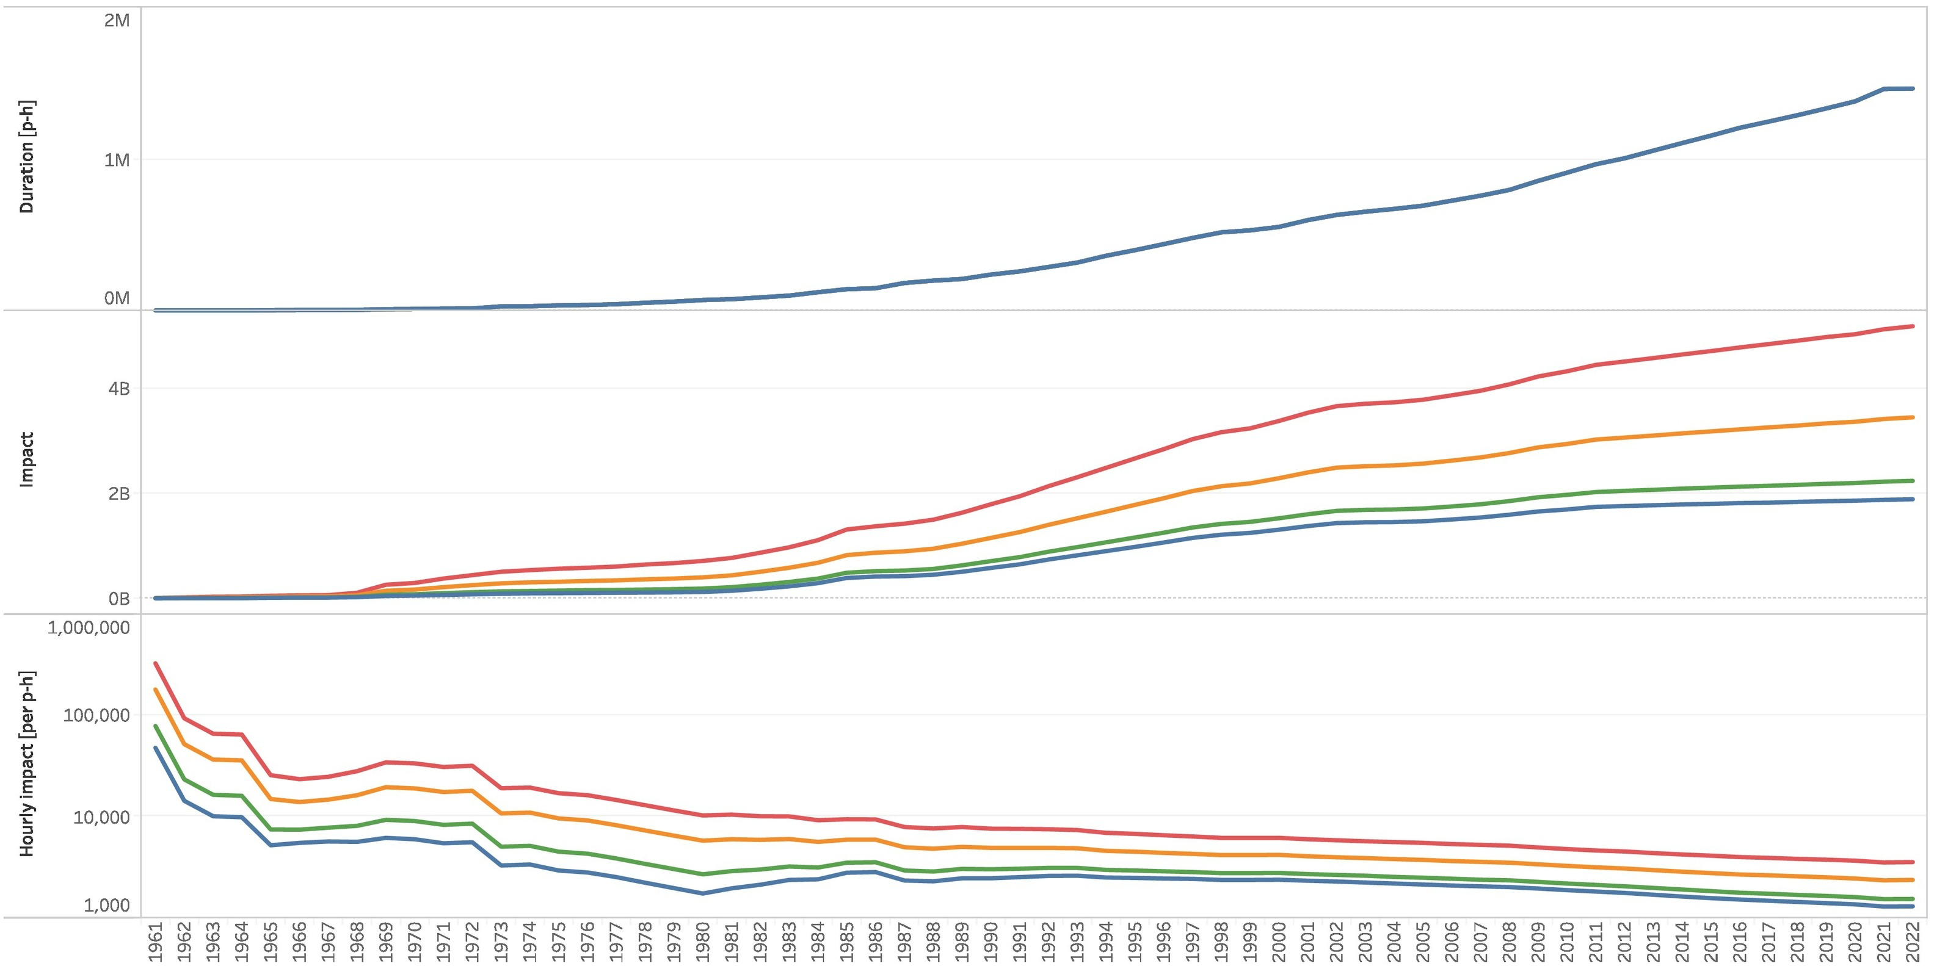
Environmental impacts per launch
High
Medium
Low
Base
Carbajales-Dale & Murphy (2022) https://doi.org/10.1016/j.scitotenv.2022.159222
Notes:
Plots:
Duration in space in person-hours [p-h] (top) and
cumulative global warming impact from all crewed and supply space launches [kg CO₂-eq] (middle) are used to calculate
hourly global warming impact [kg CO₂-eq per p-h] (bottom)
across scenarios:
base (blue),
low (green),
medium (orange), and
high (red) cases.
Note hourly impact is shown on a logarithmic scale so has dropped by around two orders of magnitude over the period, due mainly to increases in mission duration, e.g., long-term stays aboard space stations.
The hourly global warming impact has leveled off at 1500-3500 kg CO₂-eq per hour in the low-high cases.

Slide 26
Impacts per program
Program | Launches | Duration [p-h] | GHG [kT CO₂-eq] | GCEª [p-y per launch] | GCE^{b} [p-h per h]
All | 601 | 1,461,432 | 2237–5183 | 550–1300 | 2000–4600
Soyuz | 149 | 1,042,966 | 152–625 | 150–620 | 190–770
Apollo | 12 | 8158 | 89–342 | 1090–4200 | 14,020–54,070
ISS^{c} | 108 | 901,650 | 512–1071 | 700–1460 | 730–1530
Supply^{d} | 249 | 1,334,353e | 344–1226 | 200–725 | 330–1190
New Shepard | 5 | 4 | 0.17–0.19^{f} | 5 | 54,450–59,890
Inspiration | 1 | 284 | 0.76–1.19^{f} | 110–176 | 3470–5420
Carbajales-Dale & Murphy (2022) https://doi.org/10.1016/j.scitotenv.2022.159222
Notes:
Notes:
ª Global citizen equivalent: the equivalent number of annual GHG emissions generated by the average global citizen, i.e. total annual 2019 emissions (52.4 Gt CO₂-eq [40]) divided by total global human population in 2019 7.7 billion [41] for a total of 6800 kg CO₂-eq per person-year [p-y].
^{b} The equivalent hourly GHG emissions by the average global citizen, i.e. 6800 kg CO₂-eq per year divided by 8760 to give 2.3 kg CO₂-eq per person-hour [p-h].
^{c} Includes Soyuz, Shuttle, and Crew Dragon missions, but does not include supply missions.
^{d} Includes all supply (non-crewed) missions to all space stations.
^{e} Based on time spent aboard all space stations.
^{f}This value omits launch vehicle materials and manufacture impacts since the launch vehicle is reusable.

Slide 27
Why do we need to send humans into space?

Slide 28
Questions?

